Slide 1
The Glorious Mysteries
By Deacon Evan G Wittig

Slide 2
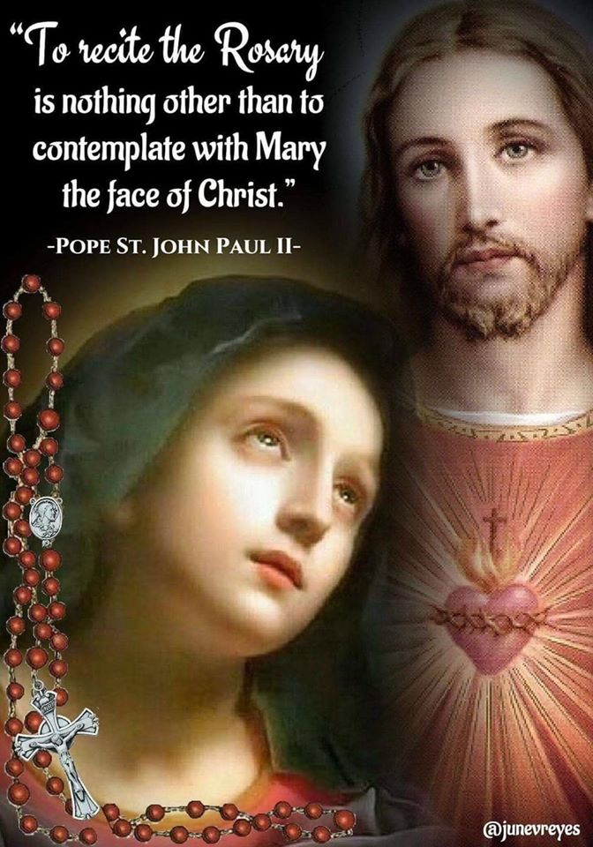
The Glorious Mysteries

Slide 3
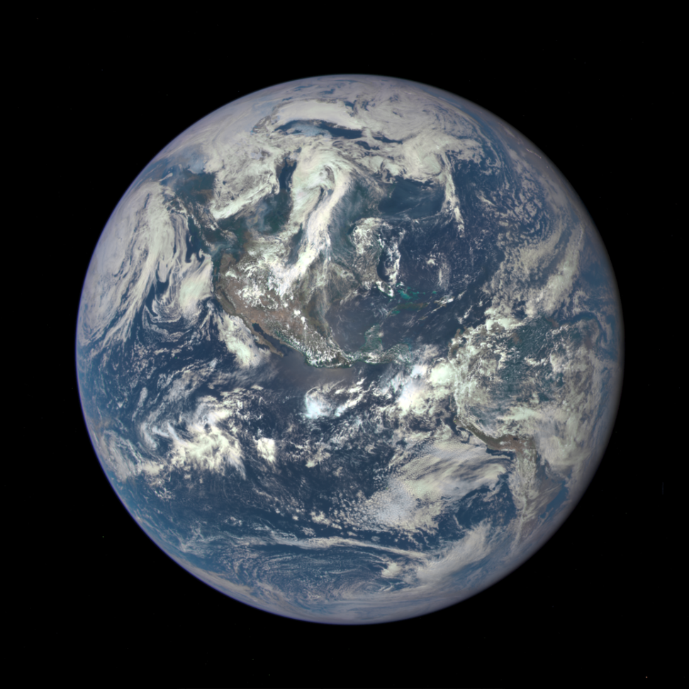
I believe in God
The Father Almighty creator of heaven and earth

Slide 4
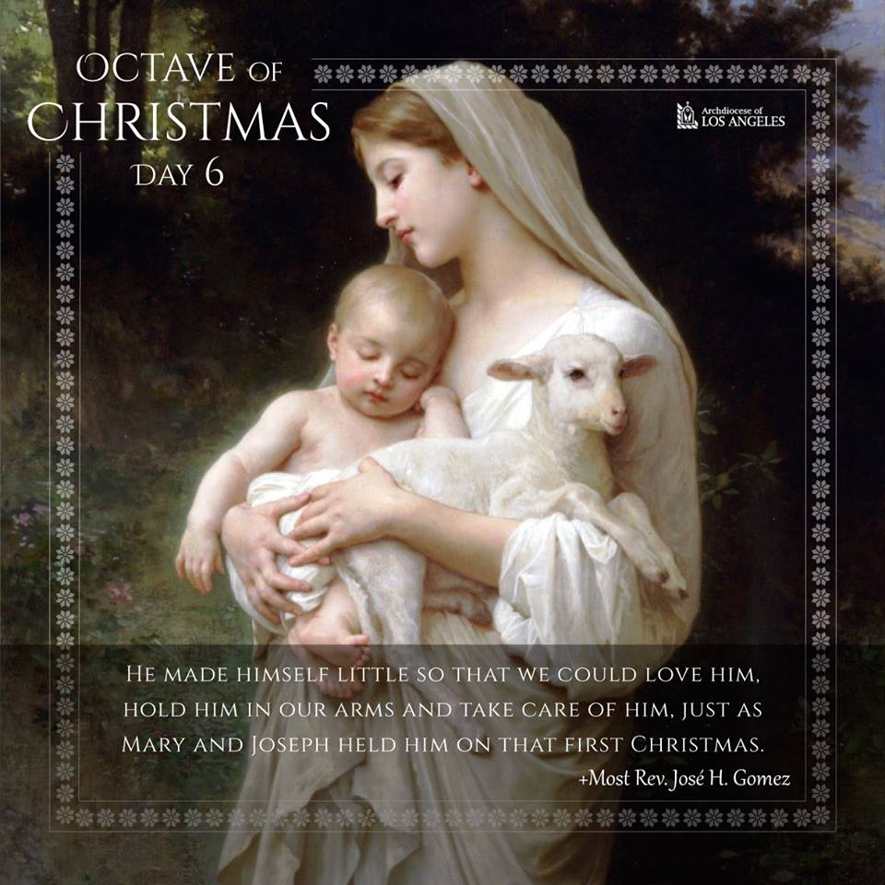
And in Jesus Christ
His only Son, our Lord, who was conceived by the Holy Spirit,
Born of the Virgin Mary

Slide 5
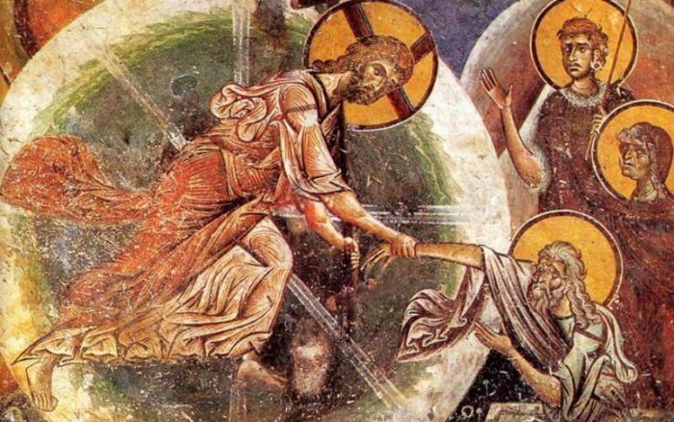
Suffered under Pontius Pilate
Was crucified, died and was buried.
He descended into
Hell, on the third day
He rose again from the dead

Slide 6
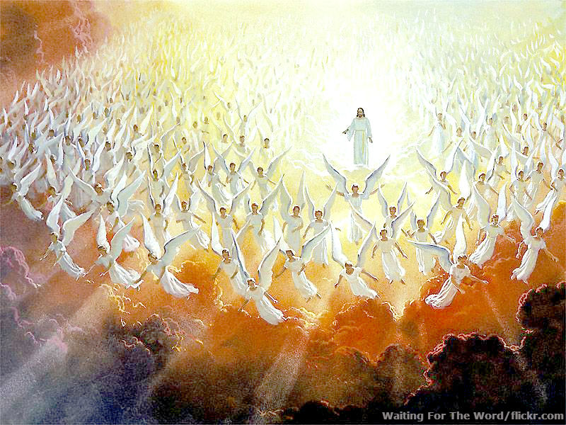
He ascended into heaven
And sits at the right hand of God, the Father Almighty, from whence he shall come to judge the living and the dead.

Slide 7
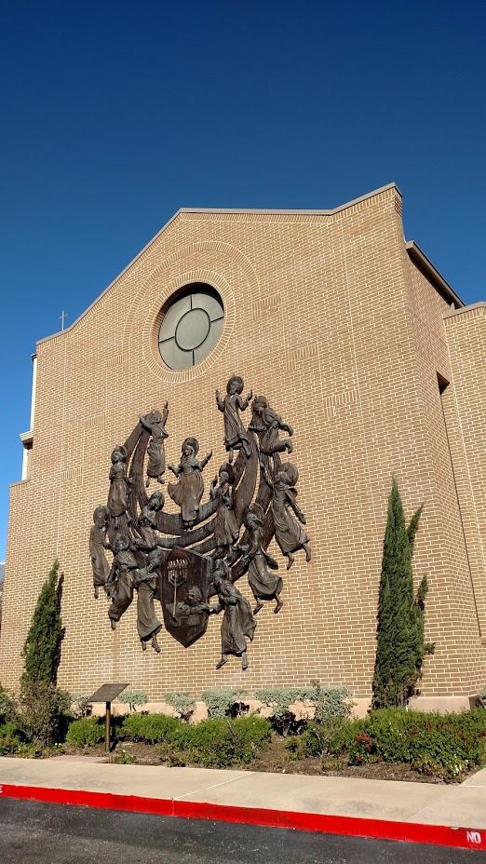
I believe in the Holy Spirit
The Holy Catholic Church, the communion of saints, the forgiveness of sins the resurrection of the body and life everlasting. Amen.

Slide 8
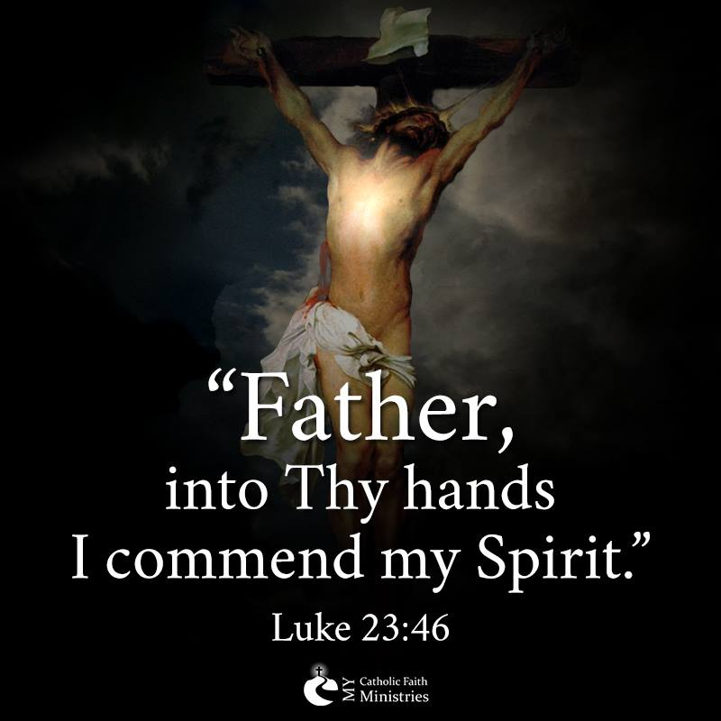
Our Father
For those persecuted for their faith and for their persecutors.
Thy kingdom come
Thy will be done, not mine.

Slide 9

Three Hail Mary’s
For an increase in
Faith
Hope
And Charity

Slide 10
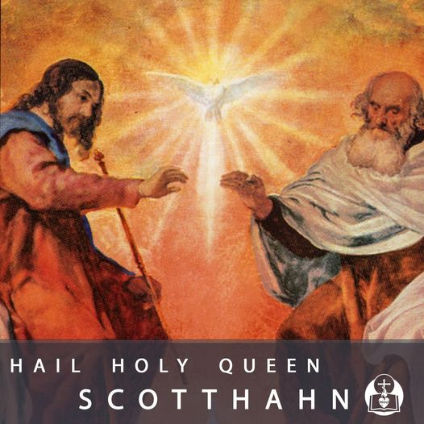
Glory be to the Father…
My Father is glorified by your bearing great fruit.
May we glorify the Lord in everything we do in our life and in our death.

Slide 11
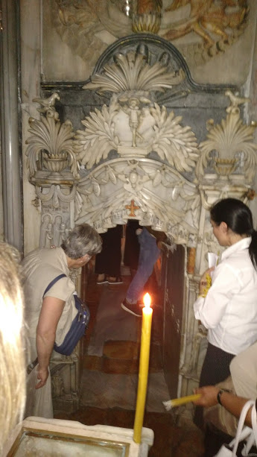
The Resurrection
Our Father…
The Sepulcher
The Holy Tomb of Jesus

Slide 12
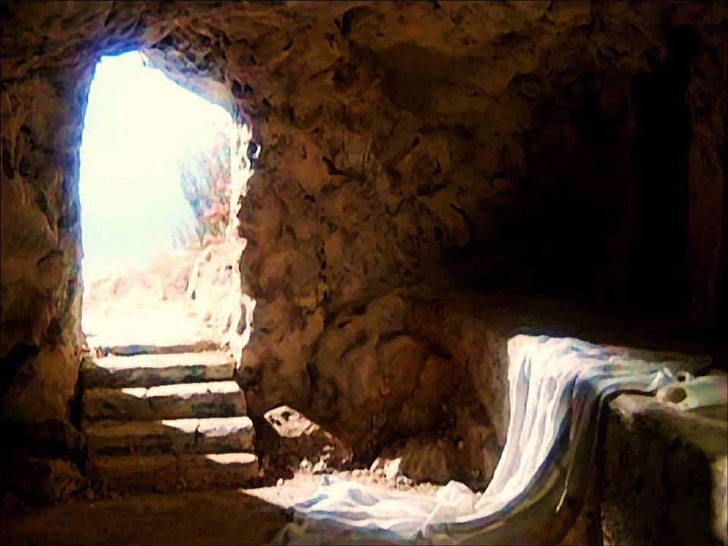
The Angel said
He is not here.
He has been raised.

Slide 13
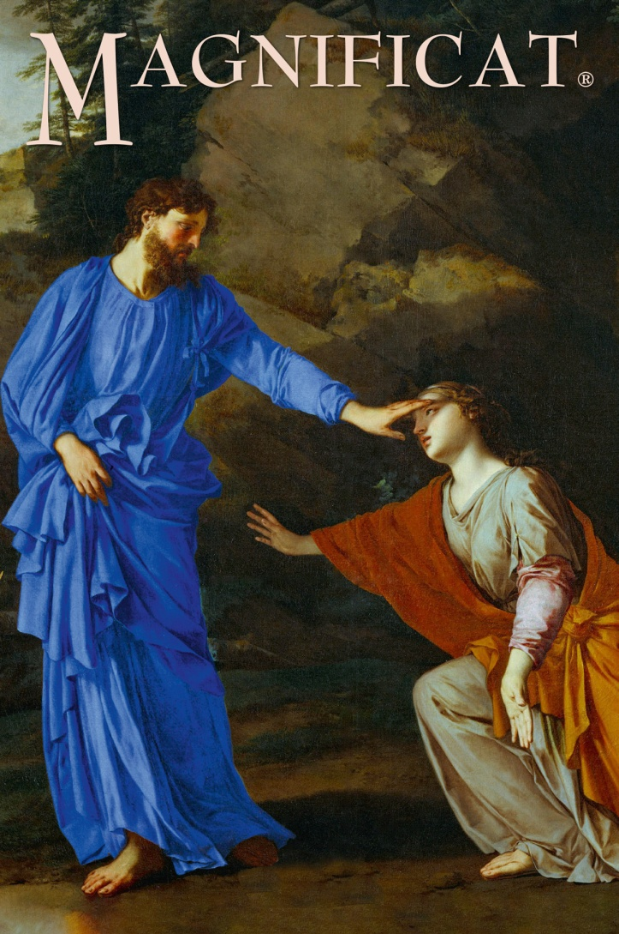
He called me by name
Let me go to my Father and your Father

Slide 14
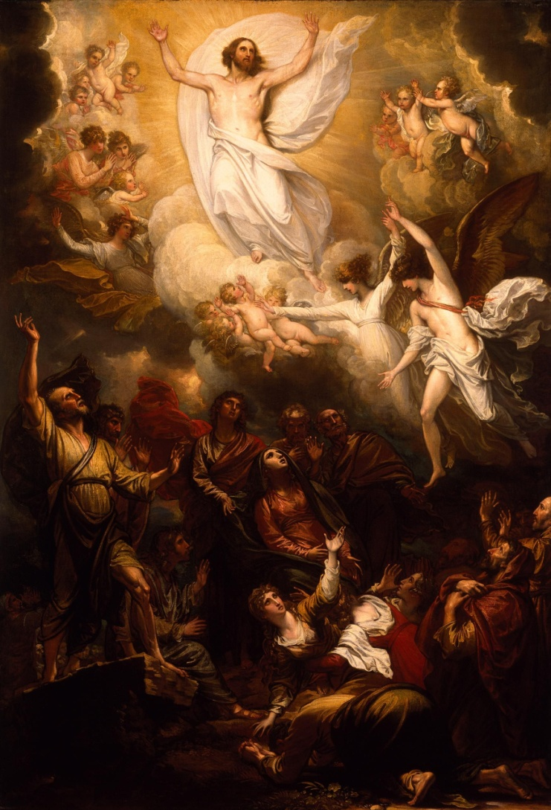
I left my tears at his tomb
Life swallowed death
God has raised up for us a mighty savior

Slide 15
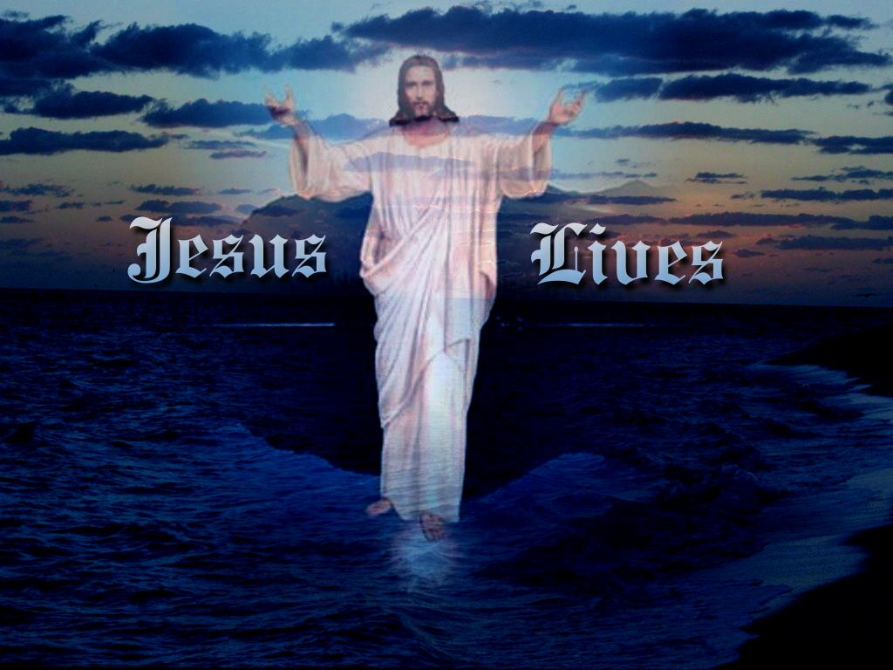
Peace be with you
Receive the Holy Spirit
Whose sins you forgive, they are forgiven

Slide 16
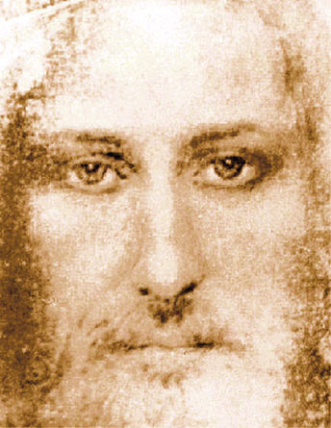
I was dead, now I am alive
One died for all, all died.
One rose for all, all rose.
Contemplate the face of Jesus with Mary

Slide 17
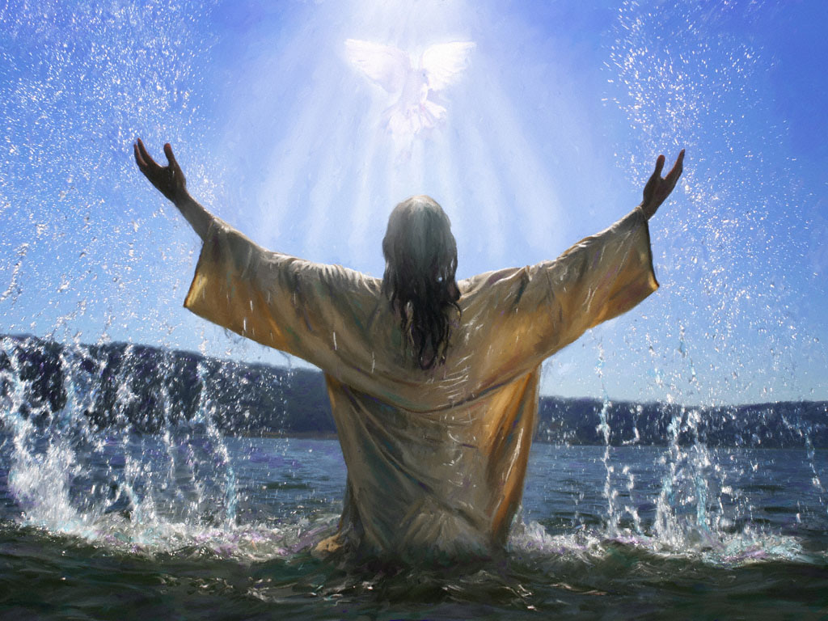
Glory be to the Father …

Slide 18
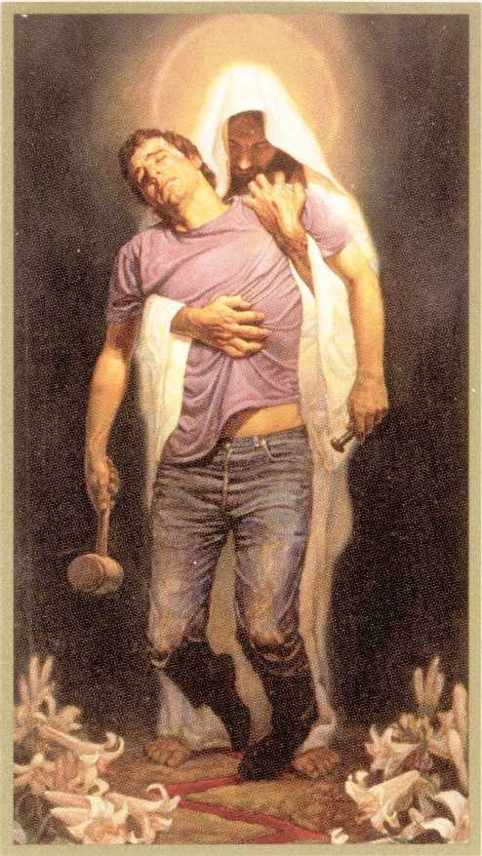
Oh my Jesus, forgive us our sins

Slide 19
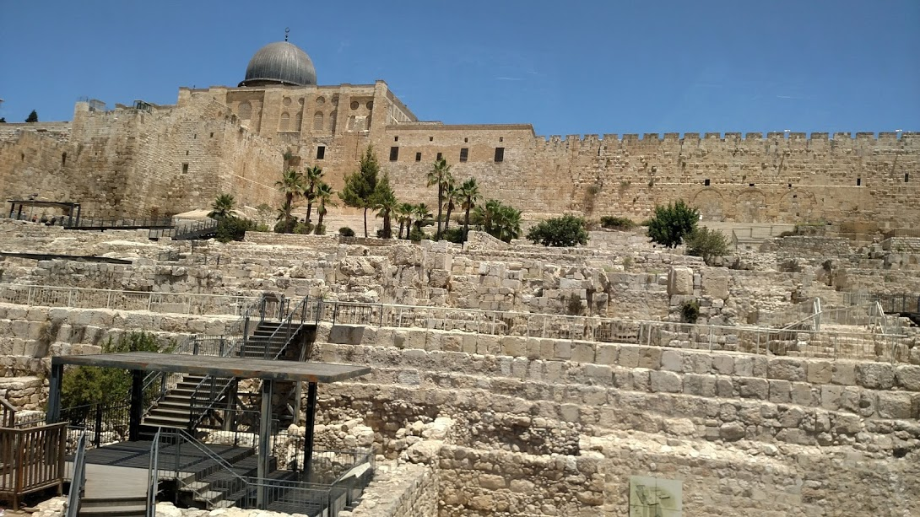
The Ascension into heaven
He took them to a hill outside Jerusalem
Wait here for the Holy Spirit, then go and make disciples
Our Father…

Slide 20
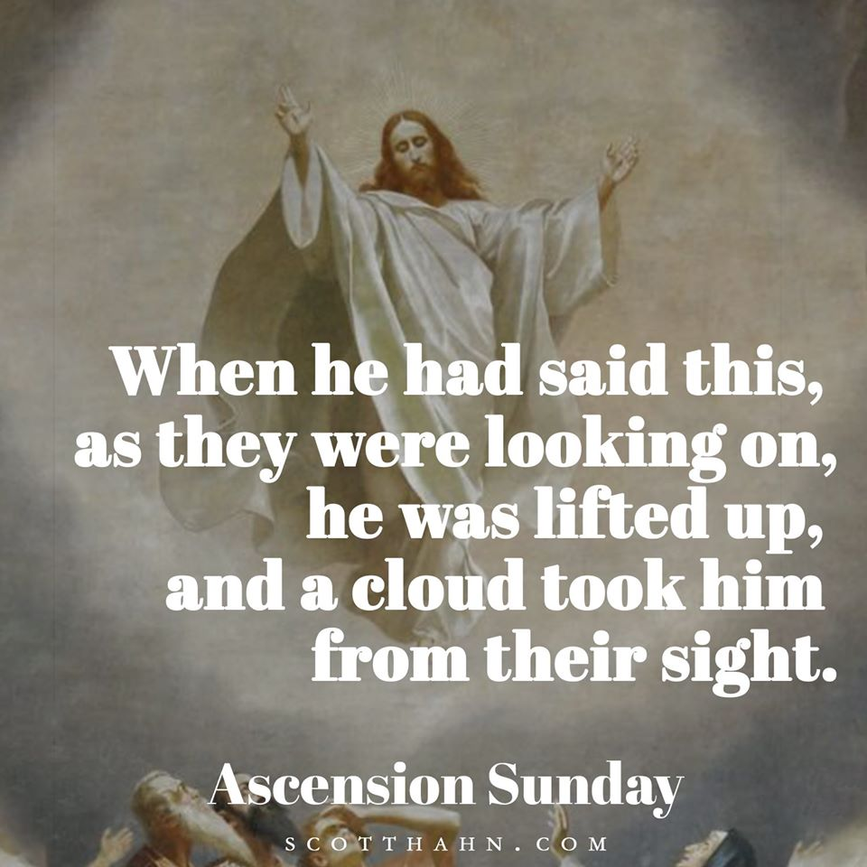
I will be with you forever
If I be lifted up, I will draw all men to me

Slide 21
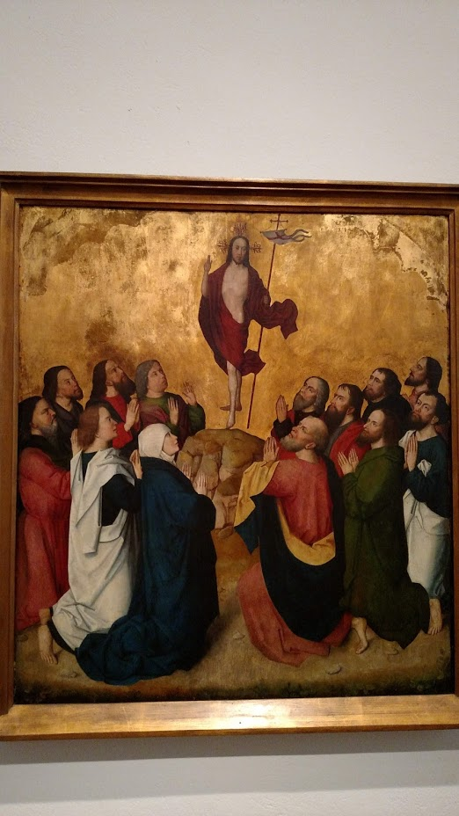
Angels asked why they stood there
He will return just as he left

Slide 22
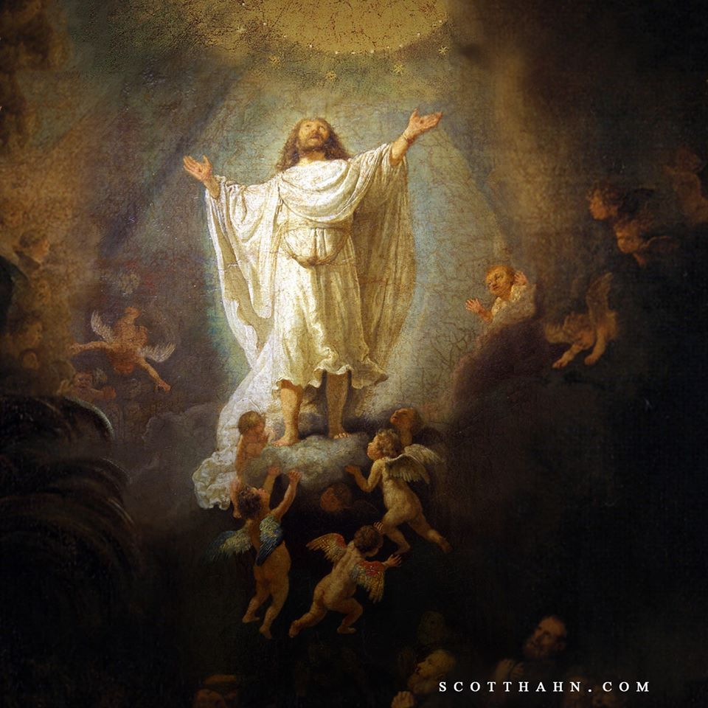
God Mounts his throne
Holy, Holy, Holy,
Lord God of hosts!
Heaven and earth are full of your glory.
Hosanna in the highest!

Slide 23
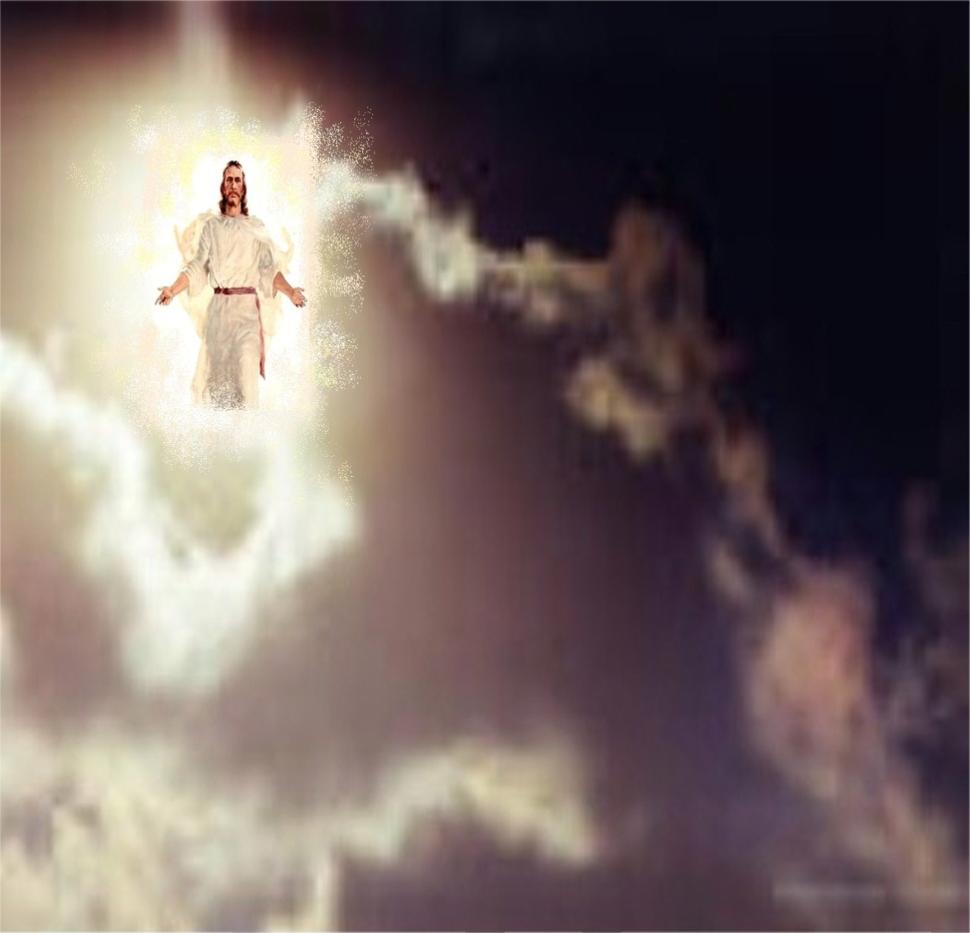
I saw one like the Son of Man

Slide 24
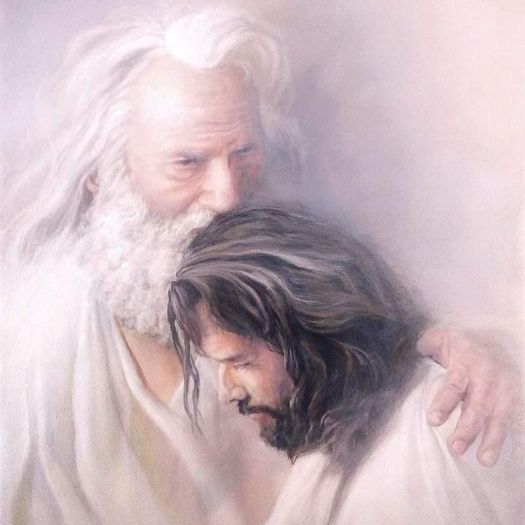
You are my beloved Son
With whom I am well pleased.
Sit at my right hand while I put your enemies under your feet

Slide 25
Glory be to the Father
And to the Son and to the Holy Spirit
As it was in the beginning is now and every shall be, world without end.
Amen.

Slide 26
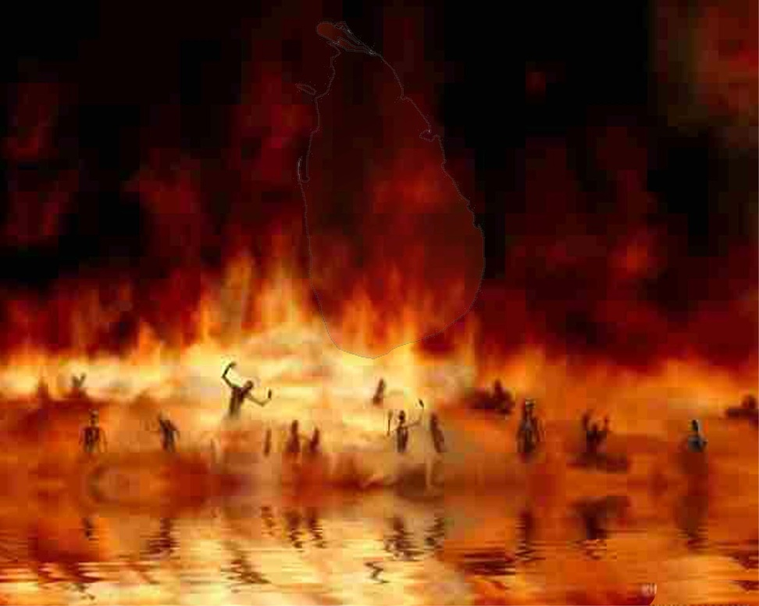
“Oh My Jesus forgive us our sins
Save us from the fires of hell, lead all souls to heaven, especially those who most need of thy mercy.”

Slide 27
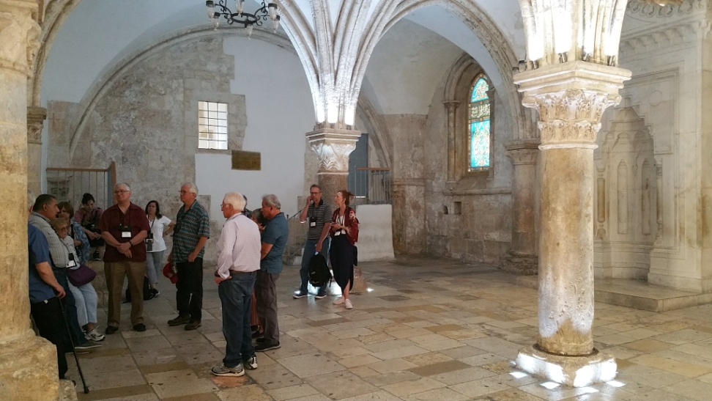
The Descent of the Holy Spirit
They prayed and fasted in the Upper Room for nine days
(the upper room)
Our Father …

Slide 28
And Mary was with them
And she taught them about the Holy Spirit
Then they heard a sound like wind

Slide 29
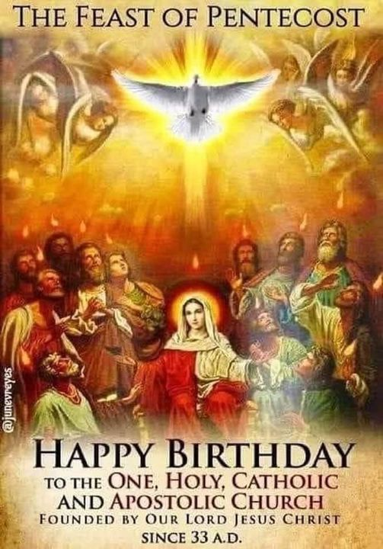
And tongues of fire came down
And the Church conceived on Calvary was born on Pentecost

Slide 30
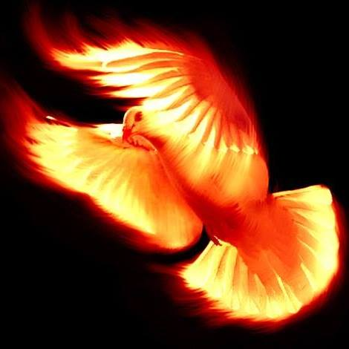
And the power of God came
And they boldly proclaimed
“Jesus is Lord!”
And they were filled with joy and exultation!

Slide 31
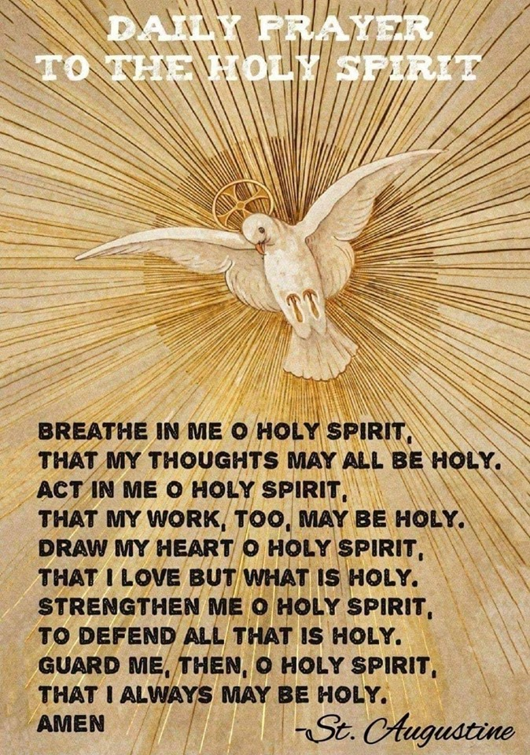
The Holy Spirit came upon them
The wind was the breath of God
Breathe on me, Breath of God
Act in me Holy Spirit
Love through me
Love of God

Slide 32
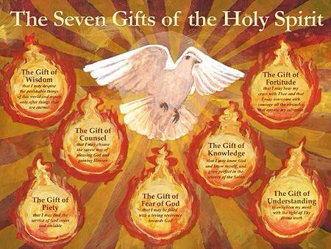
Tongues of fire, 7 gifts of God
Wisdom
Knowledge
Piety
Counsel
Fear of God
Understanding
Fortitude

Slide 33
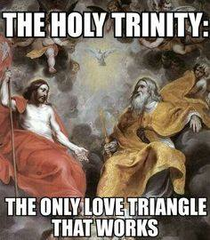
Glory be to the Father …

Slide 34
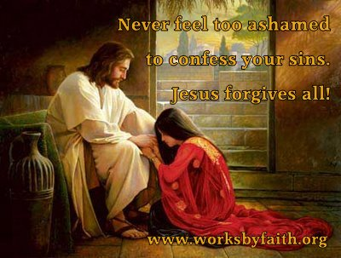
“Oh My Jesus forgive us our sins
Save us from the fires of hell, lead all souls to heaven, especially those who most need of thy mercy.”

Slide 35
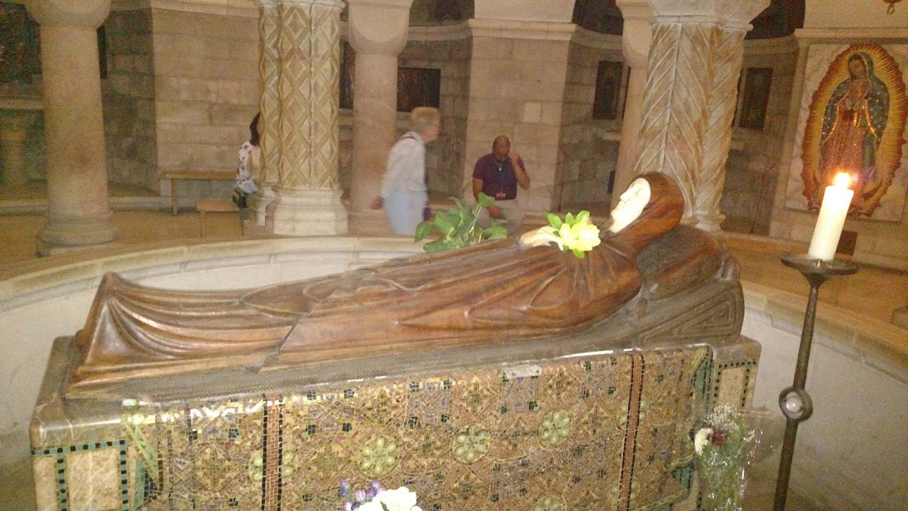
The Assumption of Mary
Our Father …
(The Domitian where they laid Mary down)

Slide 36
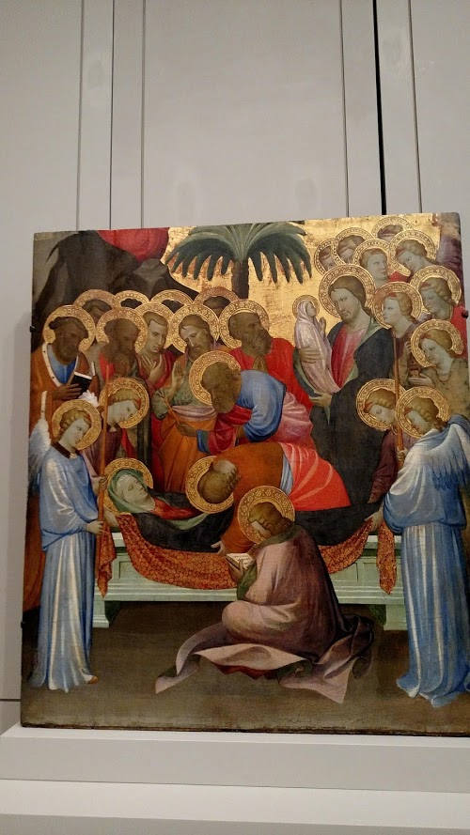
Mary slept
It was like she was sleeping.
Peter and John were there
Her body was anointed and wrapped with care

Slide 37
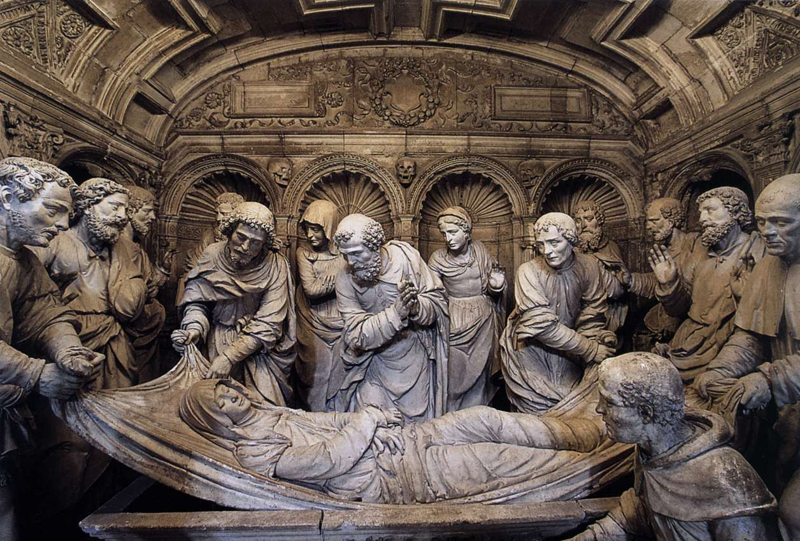
Her body was placed in a tomb
Some of the Apostles were there
Thomas arrived late and wanted to see her body
But the tomb was empty

Slide 38
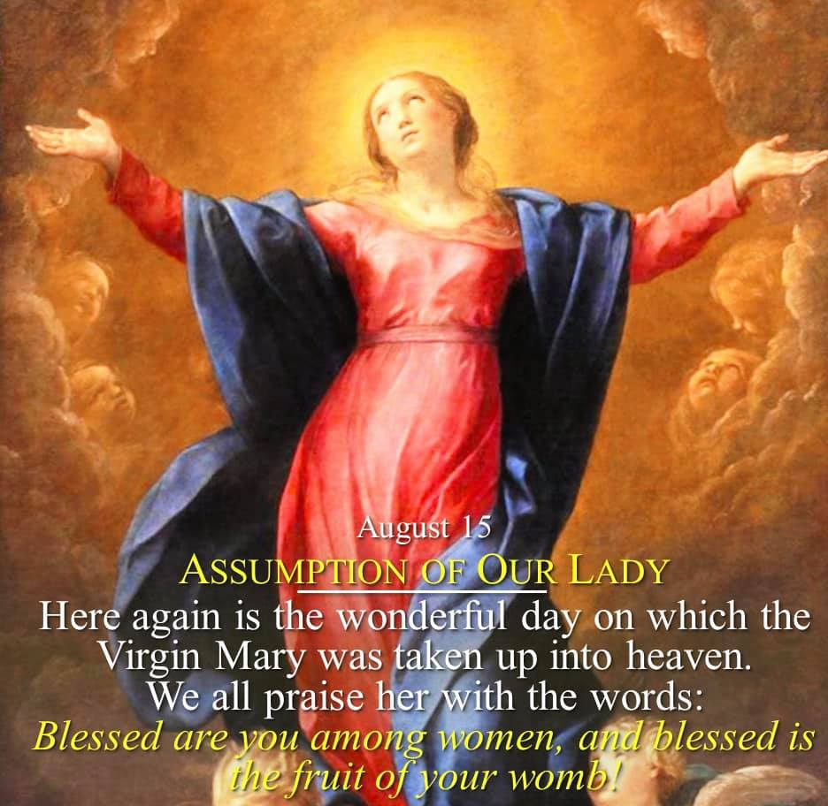
An Angel said Mary is in heaven

Slide 39
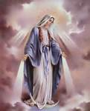
The Woman, the New Eve
She watches over you and protects you from heaven

Slide 40
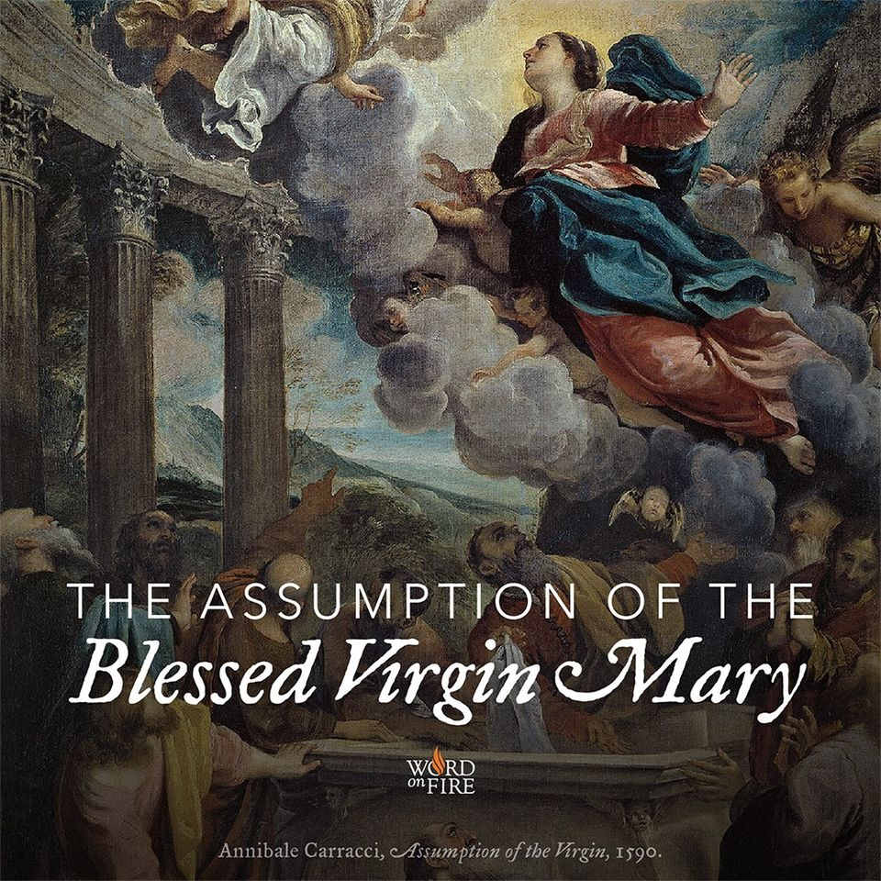
In my flesh I will see my God
We have risen with Christ
Death, where is your victory?
Death, where is your sting?

Slide 41
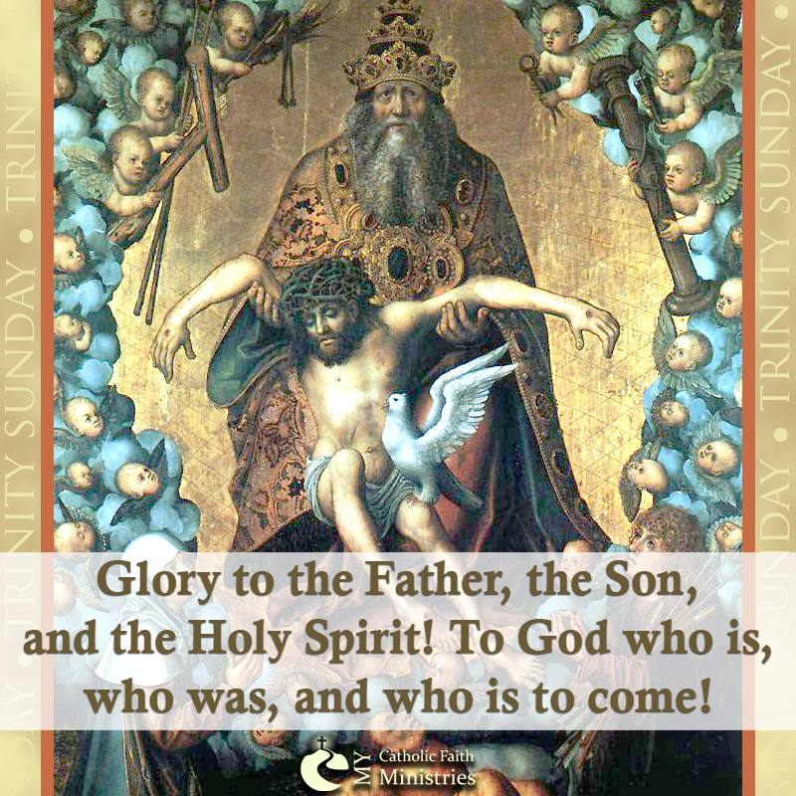
Glory be to the Father …

Slide 42
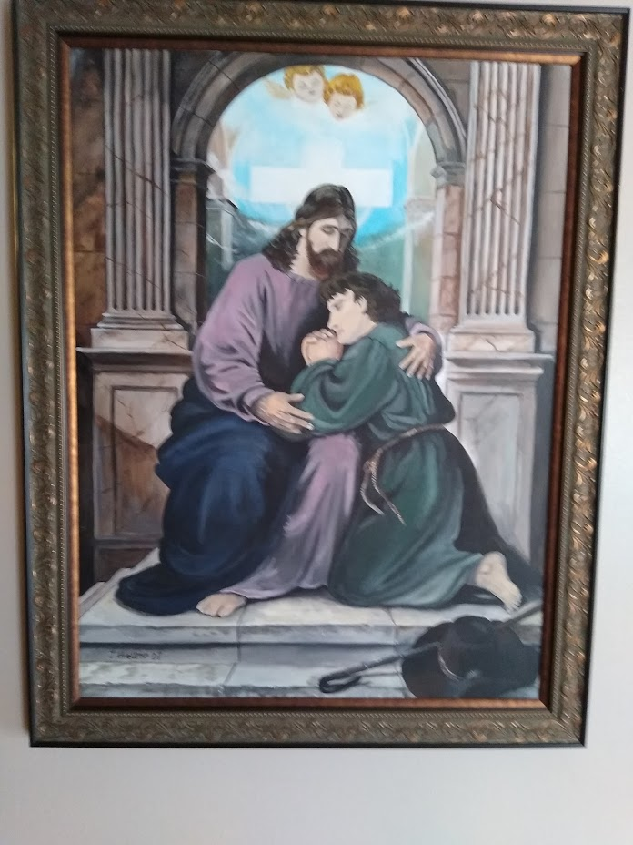
“Oh My Jesus forgive us our sins
Save us from the fires of hell, lead all souls to heaven, especially those who most need of thy mercy.”

Slide 43
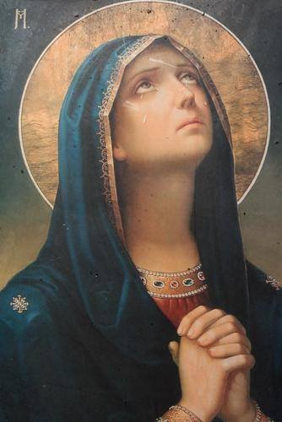
The Coronation of Mary
In heaven, Mary’s eyes looked only for Jesus
Our Father…

Slide 44
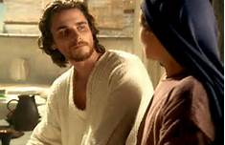
Jesus and Mary
What beautiful love between a mother and her son!

Slide 45
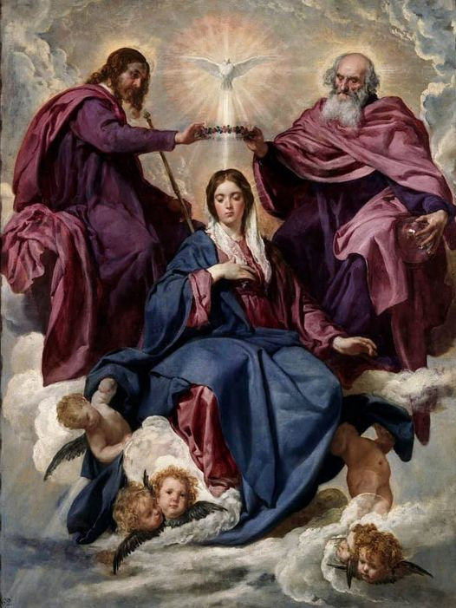
Who am I to sit near Jesus?
You are my highest creation said the Father
You are my mother, my queen said Jesus
You are my Spouse said the Holy Spirit

Slide 46
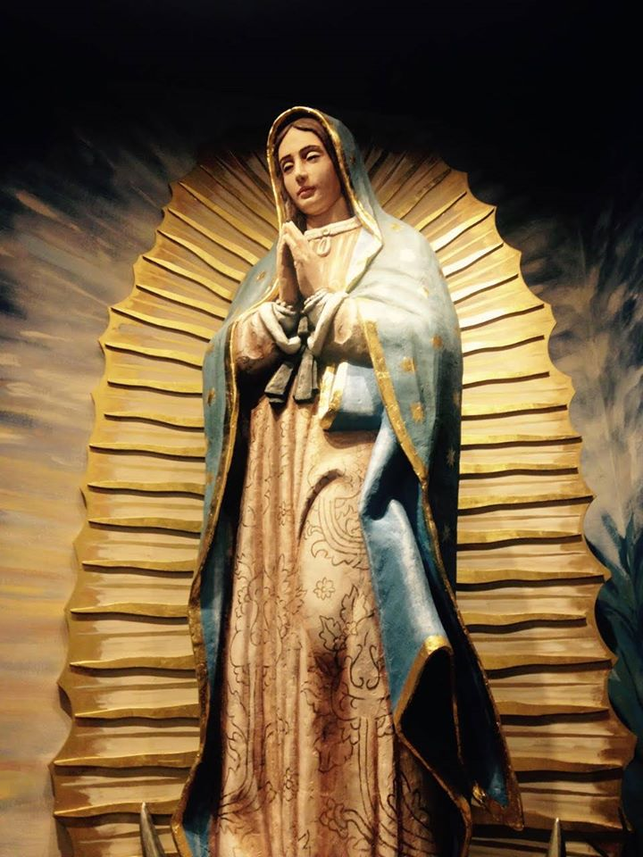
A Woman Clothed with the Sun
And the moon below her feet
Am I not your Mother?

Slide 47
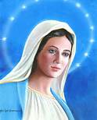
On her head a crown of 12 stars
The Twelve Tribes of Israel
The Twelve Apostles
Queen of Heaven and Earth

Slide 48
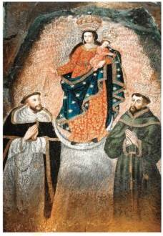
Queen of Angels and Saints
The rosary for St Dominic
The chord for St Francis
Our Lady of Las Lajas
A symbol, a model

Slide 49
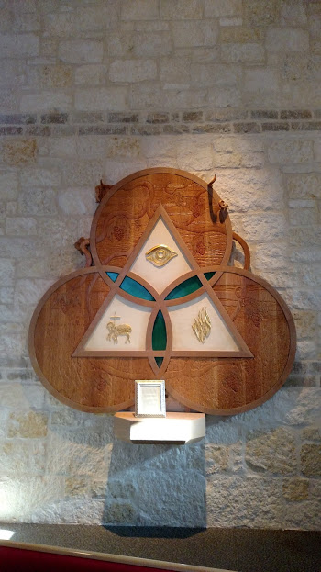
Glory be to the Father …

Slide 50
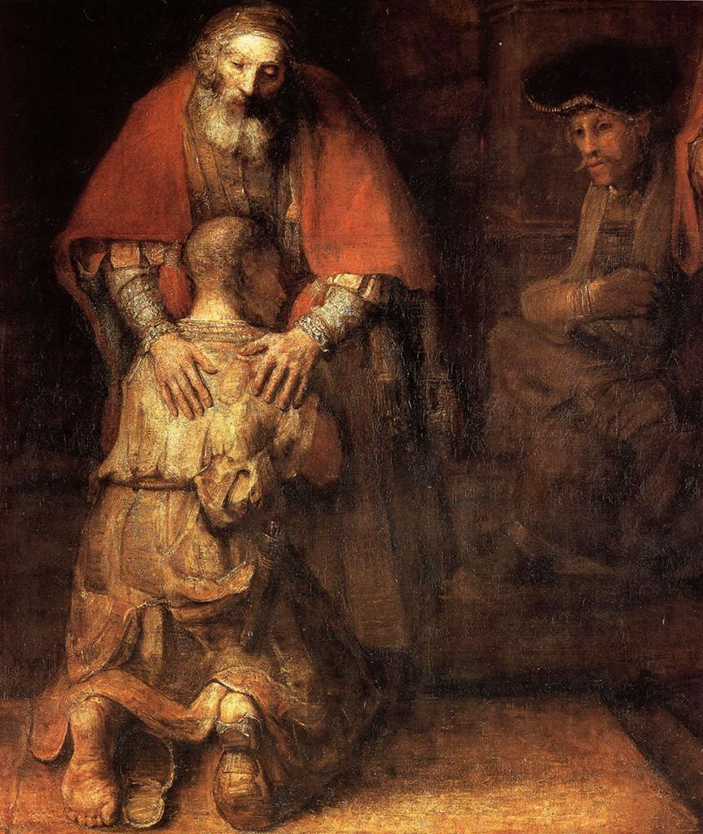
“Oh My Jesus forgive us our sins
Save us from the fires of hell, lead all souls to heaven, especially those who most need of thy mercy.”
“The Prodigal Son” by Rembrandt

Slide 51
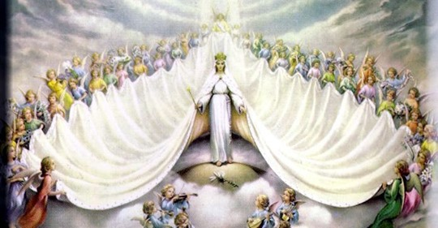
Hail, Holy Queen

Slide 52
Hail Holy Queen
Mother of mercy, our life, our sweetness, our hope. To thee we cry, poor banished children of Eve. To thee we send up our sighs, mourning and weeping in this valley of tears. Turn then, most gracious Advocate, thine eyes of mercy towards us and after this, our exile, show unto us the blessed fruit of thy womb, Jesus. O clement, oh loving, oh sweet Virgin Mary

Slide 53
Imitate and Obtain
Oh God, whose only begotten Son, by his life, death and resurrection, has purchased for us the rewards of eternal life, grant we beseech thee, that meditating on these mysteries of the most holy rosary of the Blessed Virgin Mary, we may imitate what they contain and obtain what they promise, through the same Christ our Lord. Amen

Slide 54
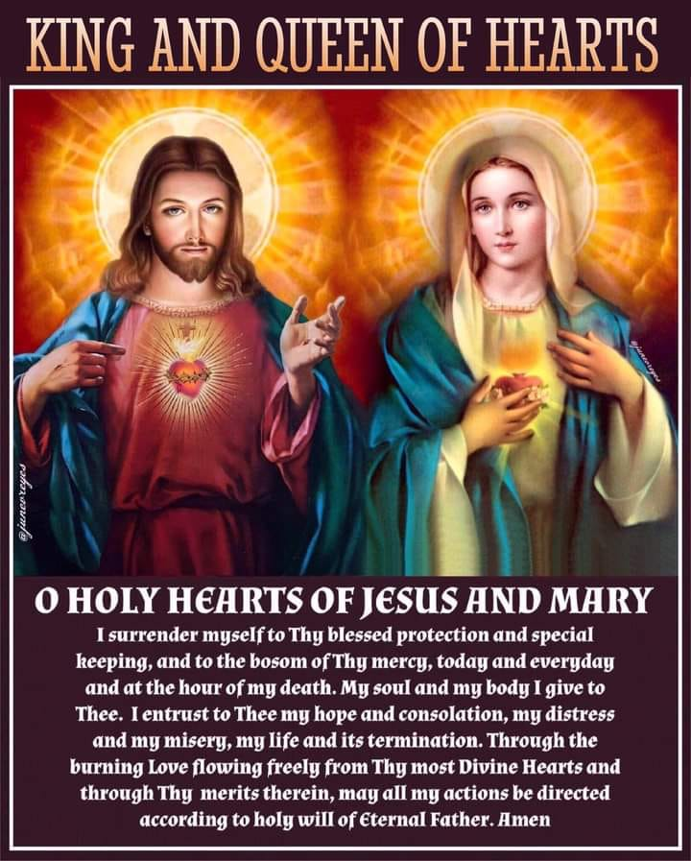
May we imitate and obtain

Slide 55
A special indulgence
Pray and Our Father, a Hail Mary and Glory be for the intentions of the Holy Father.
Let us also pray to St Joseph, husband of Mary. Jesus called him “dad.”
He is the only savior of the Savior, second only to Mary in the heavenly court.

Slide 56
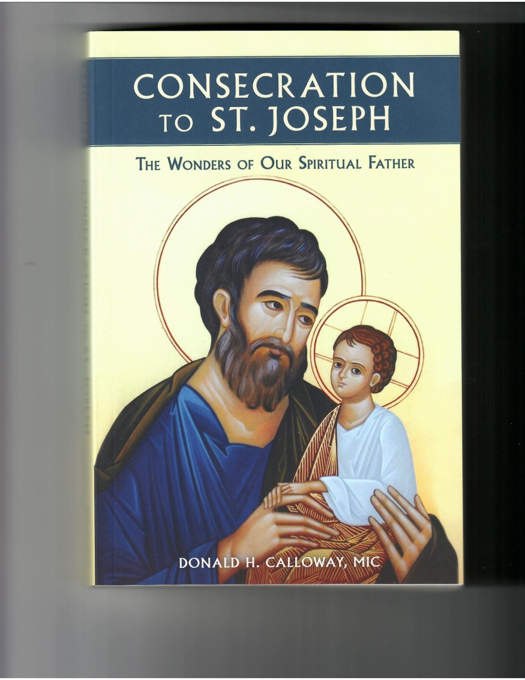
St Joseph pray for us

Slide 57
Prayer to St Joseph
To you, blessed Joseph, we come in our tribulation, and having implored the help of your most holy Spouse, we confidently invoke your patronage also. (Pope Leo XIII)

Slide 58
Consecration to St Joseph
By St Bernardine of Siena
O my beloved Saint Joseph, adopt me as thy child.
Take charge of my salvation; watch over me day and night;
preserve me from occasions of sin; obtain for me purity of body.
Through thy intercession with Jesus, grant me a spirit of sacrifice, humility, self-denial, burning love of Jesus in the Blessed Sacrament, and a sweet and tender love for Mary, my mother.
Saint Joseph, be with me living, be with my dying, and obtain for me a favorable judgment from Jesus, my merciful savior. Amen

