Slide 1
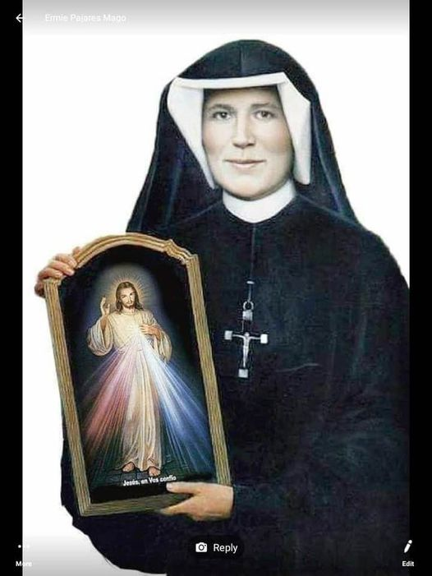
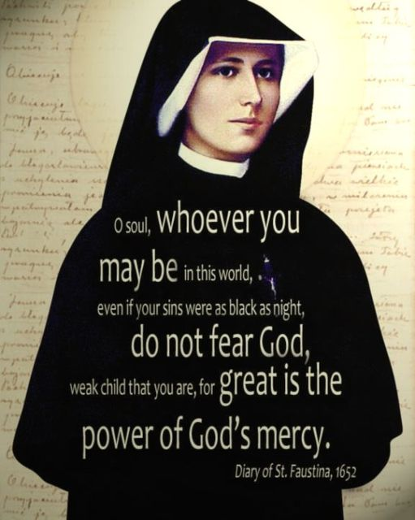
The Chaplet of Divine Mercy

Slide 2
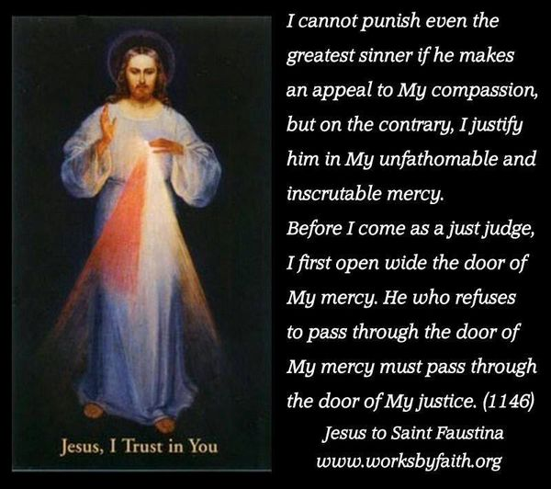
Divine Mercy Chaplet

Slide 3
Opening Prayer
You expired, Jesus, but the source of life gushed forth for souls and the ocean of mercy opened up for the whole world. O Font of Life, unfathomable Divine Mercy, envelop the whole world and empty yourself out upon us. Diary 1319

Slide 4
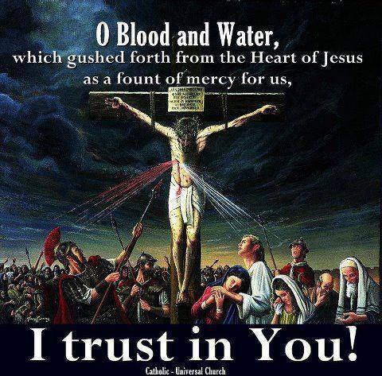
O blood and water, which gushed forth from the heart of Jesus as a fount of mercy for us. I trust in you.
Three times

Slide 5
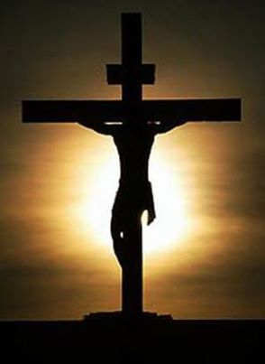
I believe in my heart
Our Father
Hail Mary
The Apostles’ Creed

Slide 6
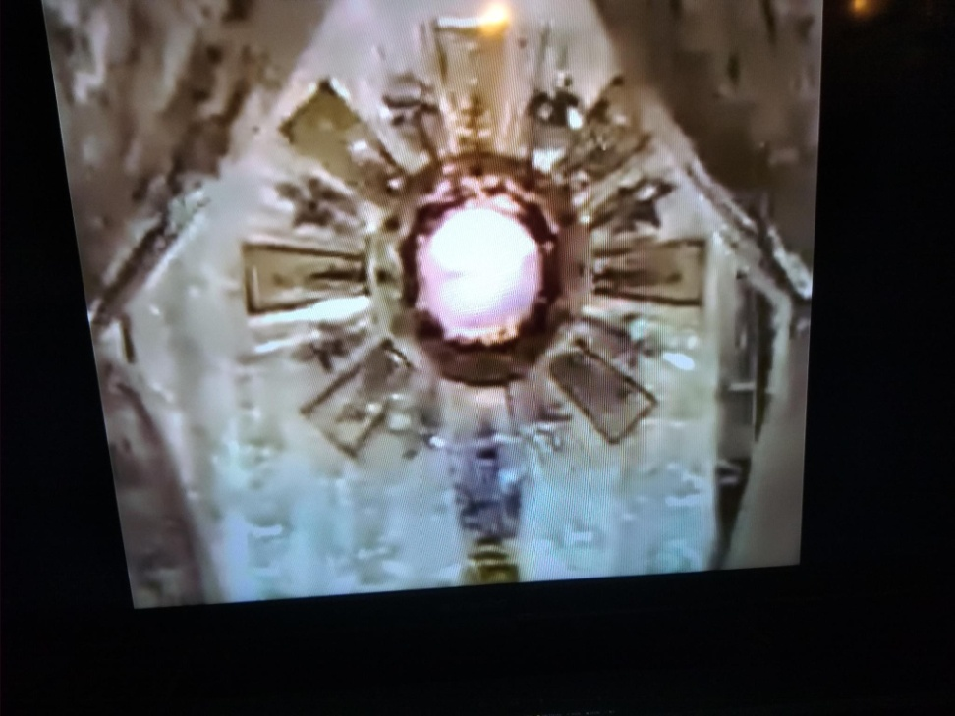
Eternal Father, I offer you the body and blood, soul and divinity of your dearly beloved Son, our Lord Jesus
Christ. In atonement for our sins and those of the whole world.

Slide 7
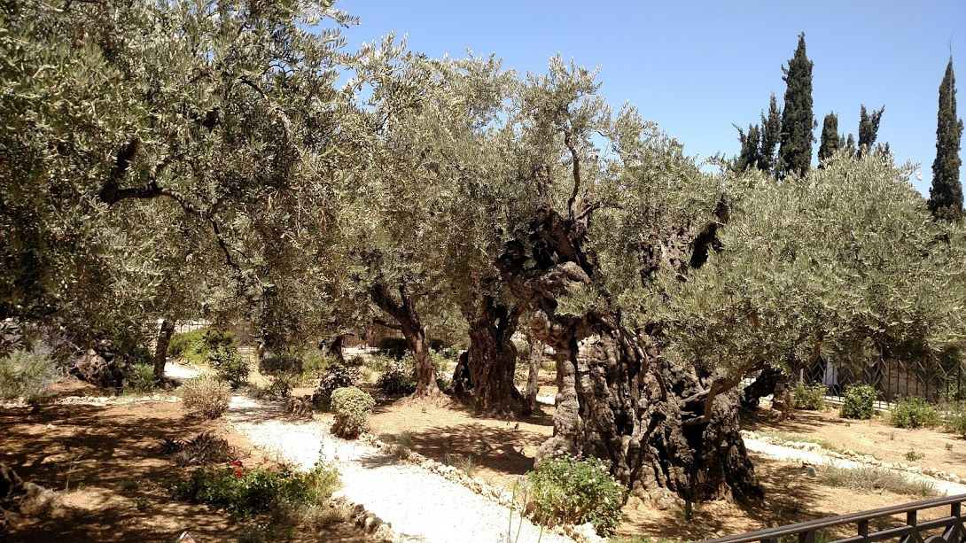
Mount of Olives
After the Passover Meal, they sang a hymn and went to the mount of Olives

Slide 8
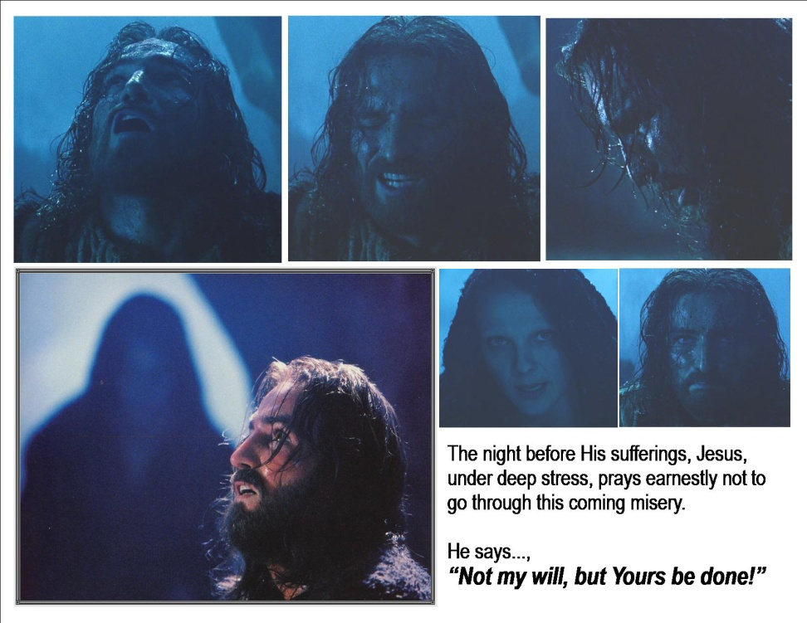
Gethsemane
Jesus told his disciples, I am sorrowful unto death, stay awake, watch and pray with me

Slide 9
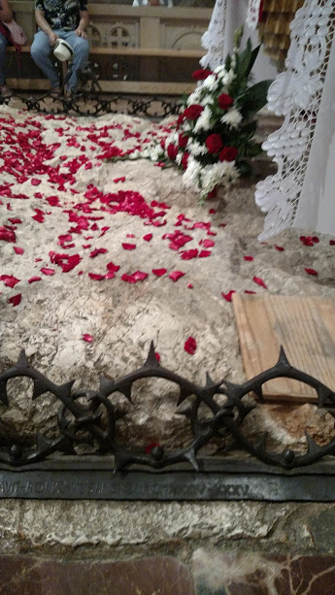
Not my will, but thine be done
His Divine Spirit saw all the sins of the world, his poor human body could not withstand the strain. His sweat became as drops of blood.

Slide 10
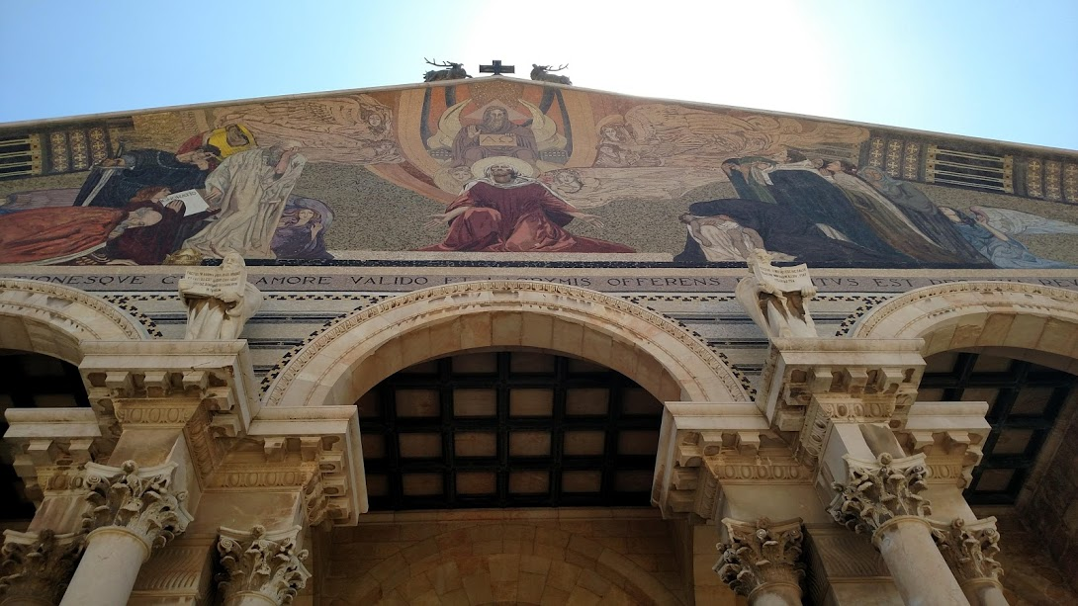
Sleeping disciples
Could you not watch one hour with me?

Slide 11
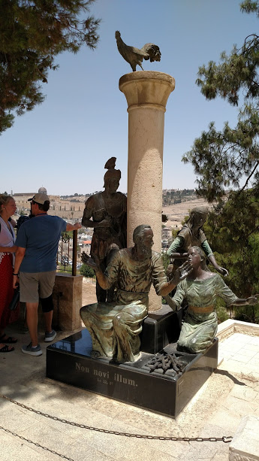
Peter denies, cock crows
Jesus told Peter, “before the cock crows, you will have denied me three times.”
And Peter went out and wept bitterly.

Slide 12
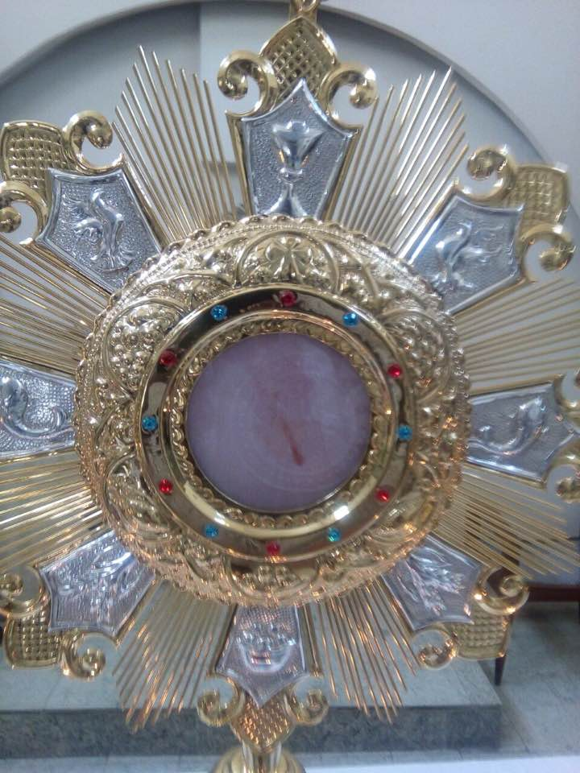
Eternal Father, I offer you the body and blood, soul and divinity of your dearly beloved Son, our Lord Jesus
Christ. In atonement for our sins and those of the whole world

Slide 13
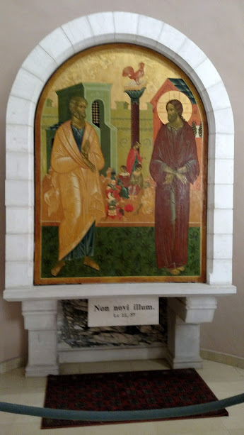
Trial with Caiphas
“Are you the Messiah, the son of God?”
“I am, and you will see the Son of Man at the right hand of the power of God.”

Slide 14
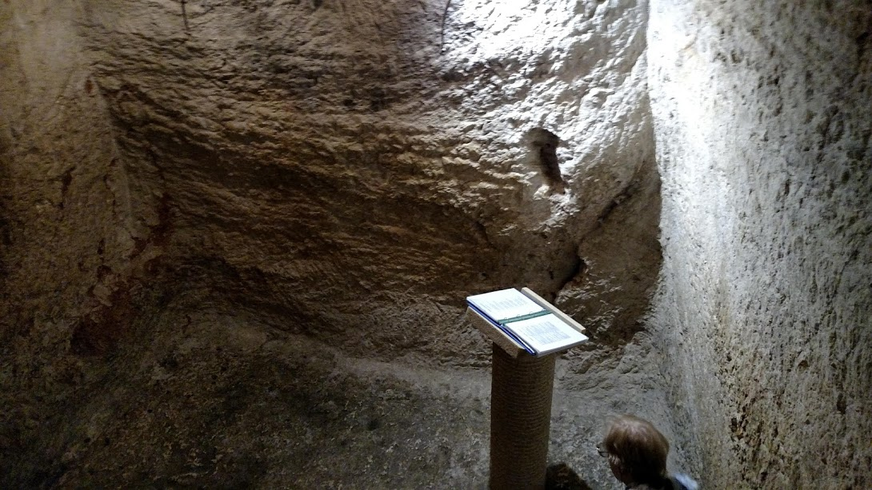
A prisoner below ground
The Son of Man will spend three days and three nights in the belly of the earth.
You plunge me into the bottom of the pit,
the darkness of the abyss is my only friend.
Ps 88

Slide 15
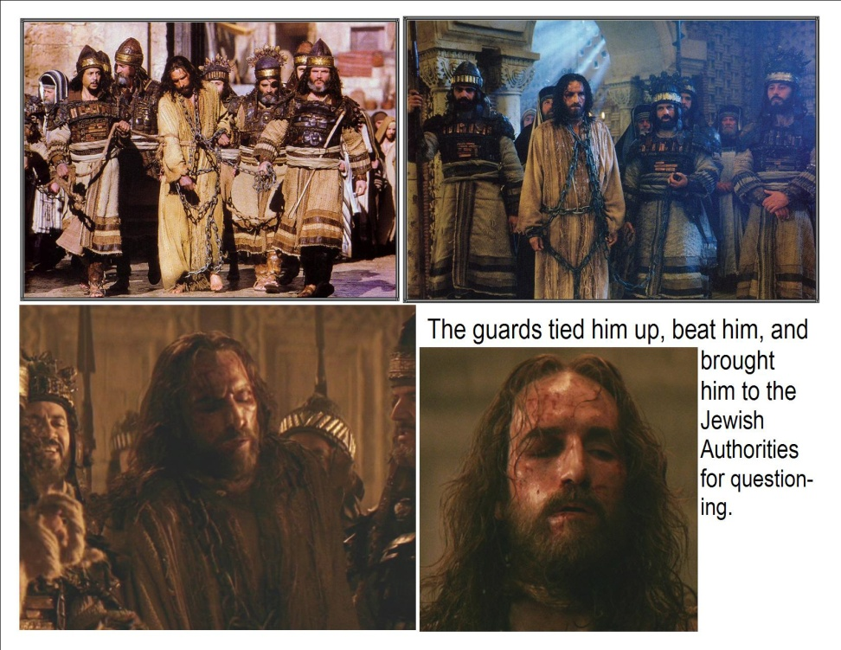
Beaten and mocked
They let out all their hatred upon him.
“My face I did not shield from buffets, they plucked my beard.”

Slide 16
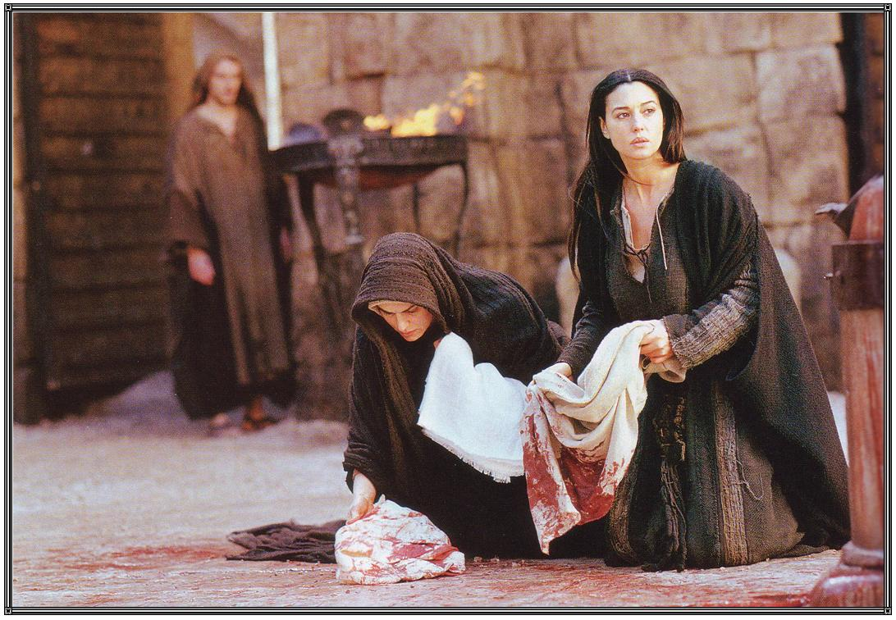
He was scourged, blood shed
My blood will be shed for you, for the forgiveness of sins
They washed their robes in the blood of the lamb

Slide 17
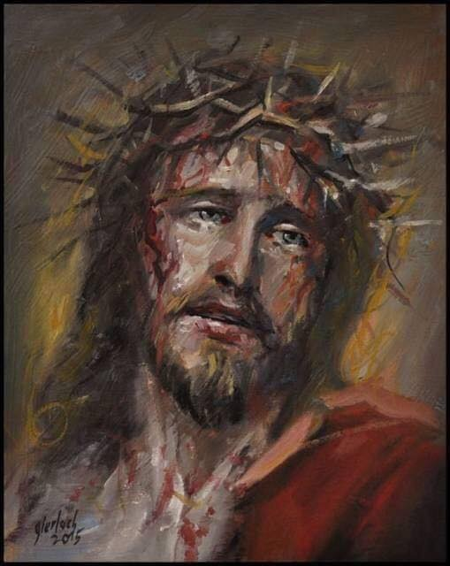
Crowned with thorns
The irony:
A fake crown for the real king of the world

Slide 18
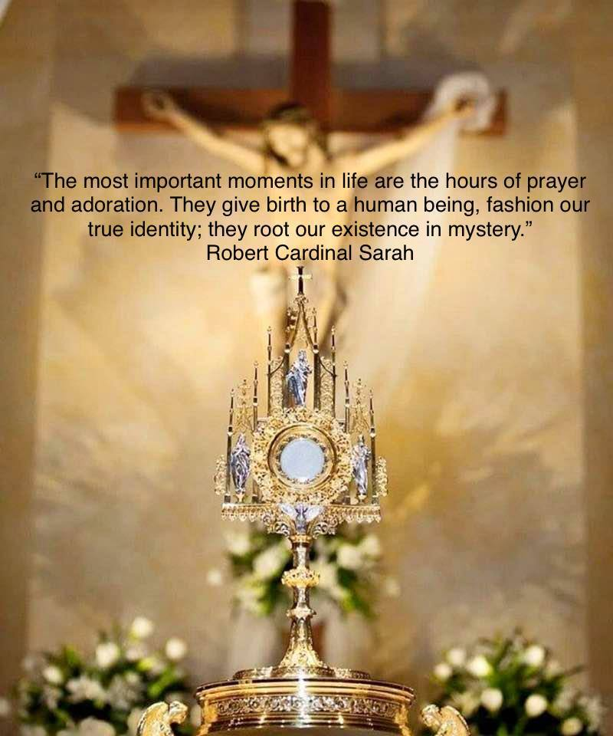
Eternal Father, I offer you the body and blood, soul and divinity of your dearly beloved Son, our Lord Jesus
Christ. In atonement for our sins and those of the whole world

Slide 19
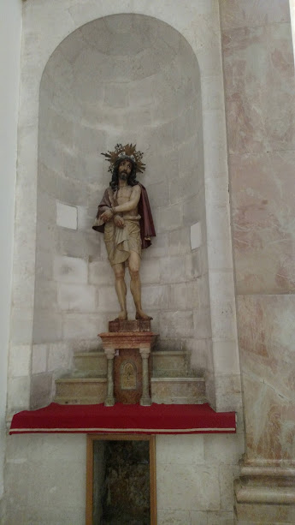
Behold the man
This is the One Man
One died for all,
all died

Slide 20
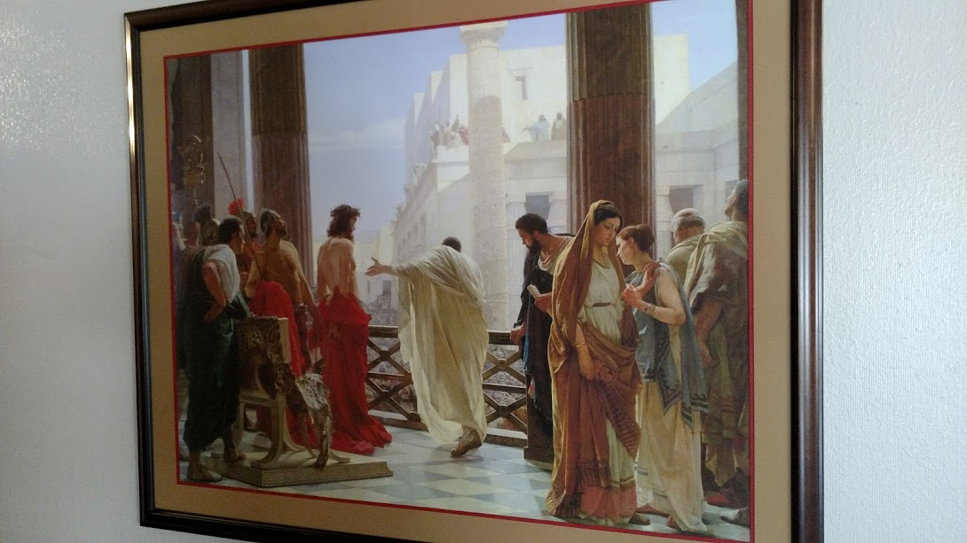
Pilate and the People
What would you have me do with Jesus of Nazareth?
“Crucify him!”
“You’d crucify your king?”

Slide 21
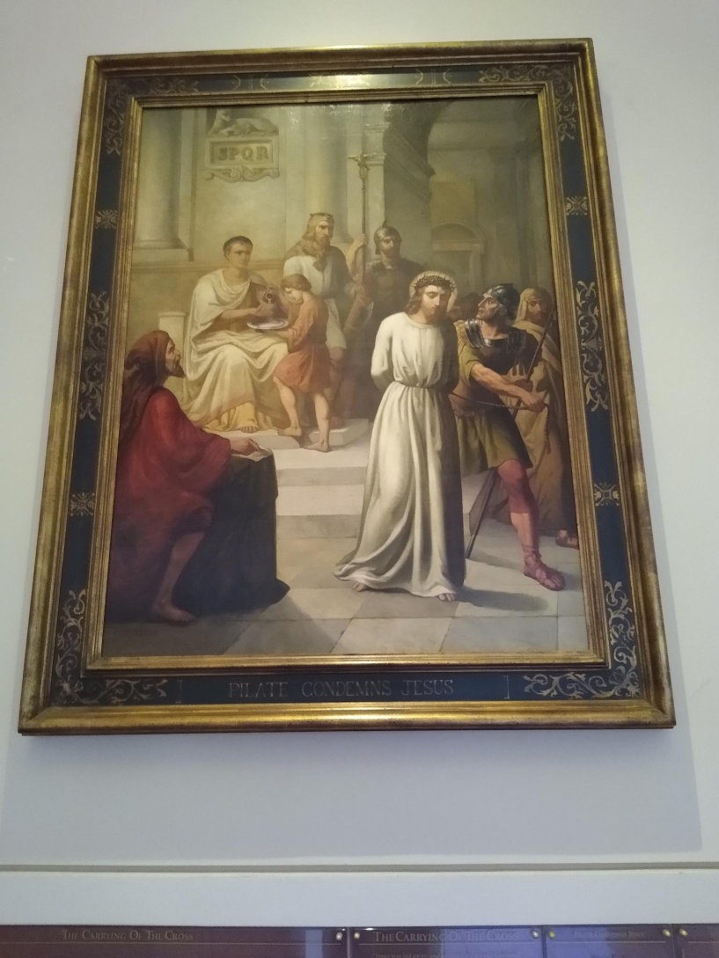
Jesus condemned
We have no king but Caesar!
His blood be on us and on our children.

Slide 22
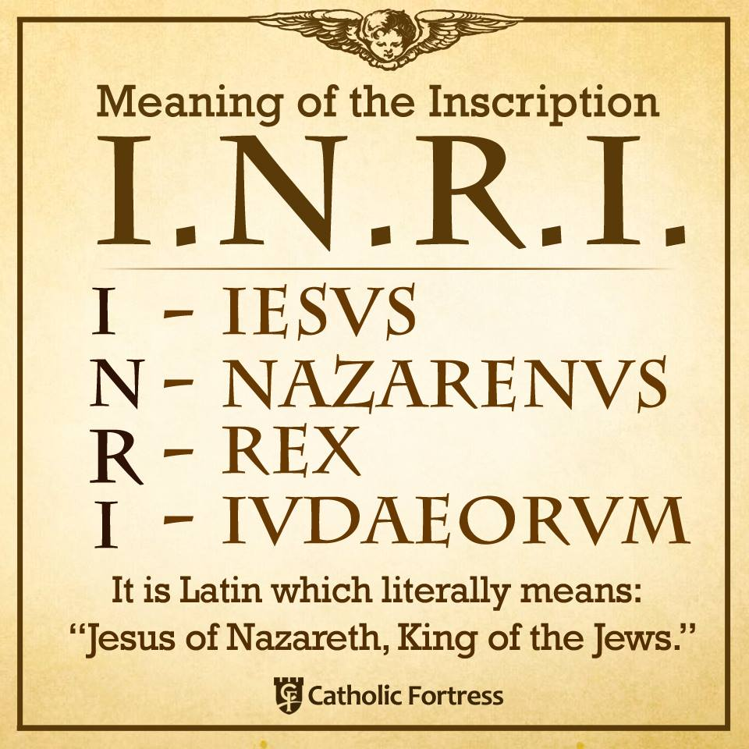
His crime: King of the Jews
This is the sign that hung on the cross.
“Jesus of Nazareth, King of the Jews”
He rules the kingdom of God

Slide 23
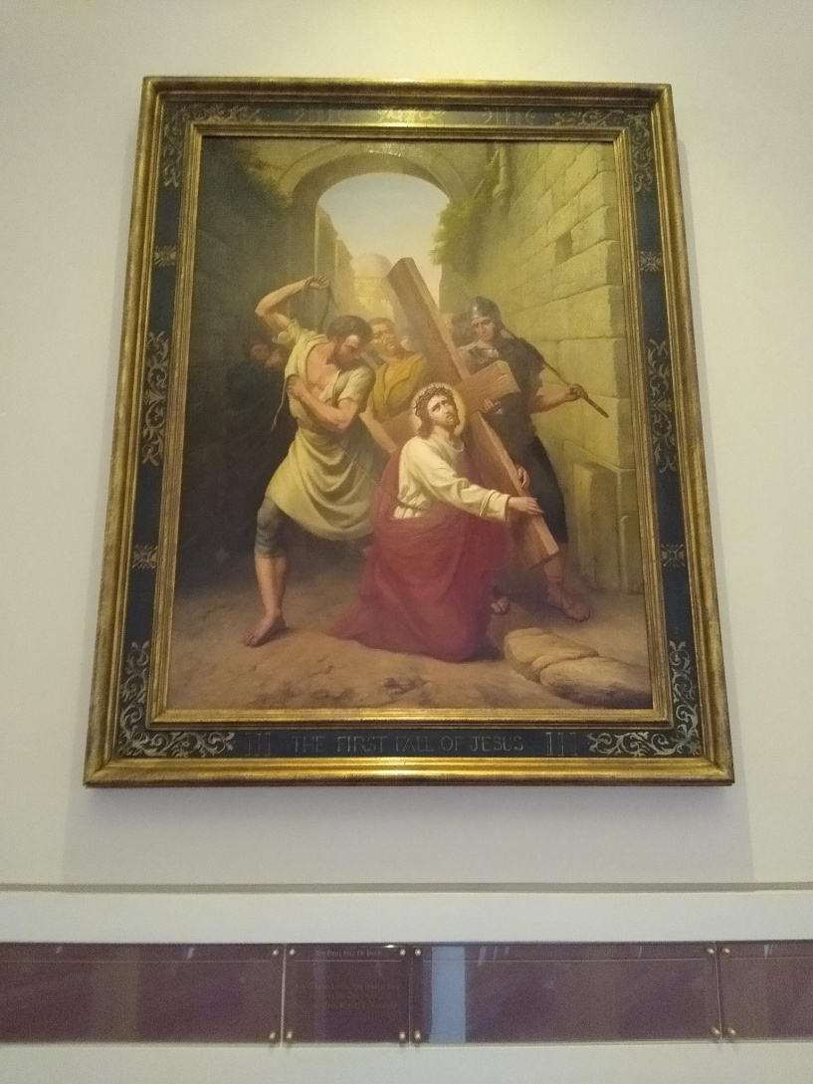
He falls under the weight
He carries us, this God of ours.
We are his burden

Slide 24
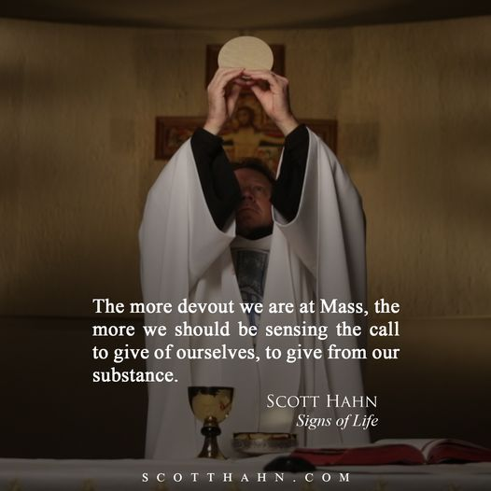
Eternal Father, I offer you the body and blood, soul and divinity of your dearly beloved Son, our Lord Jesus
Christ. In atonement for our sins and those of the whole world

Slide 25
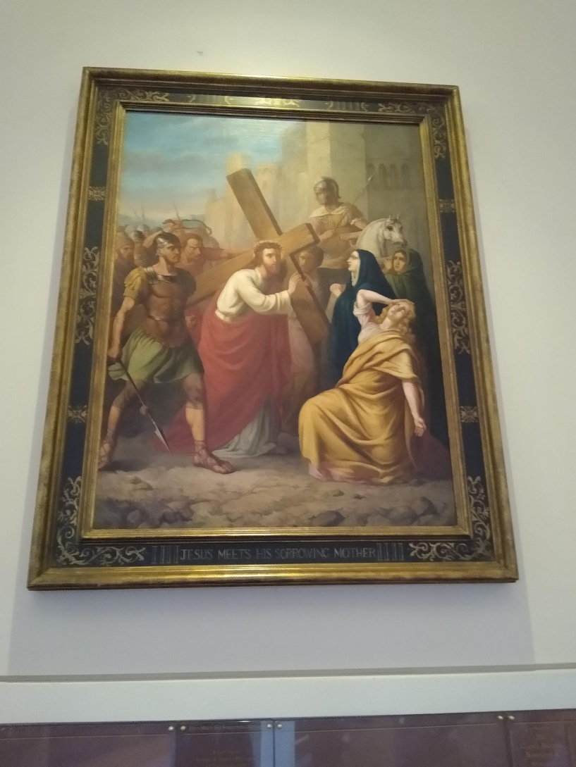
He meets his mother
Mary said to Jesus:
I am here with you, let it be as God wills.
I love you, I will not leave you.
Let me die with you

Slide 26
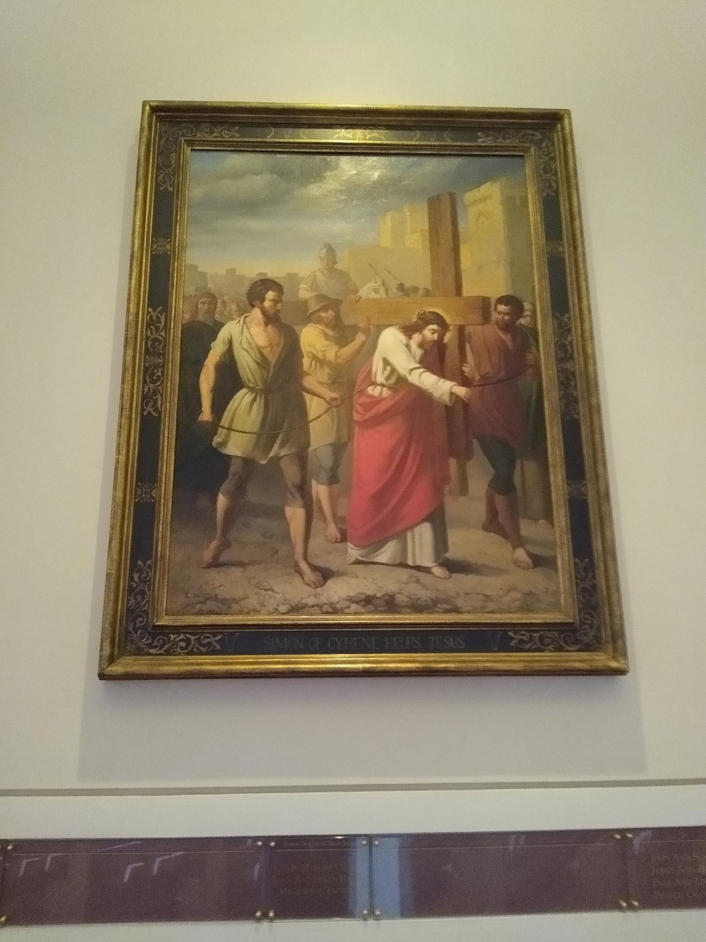
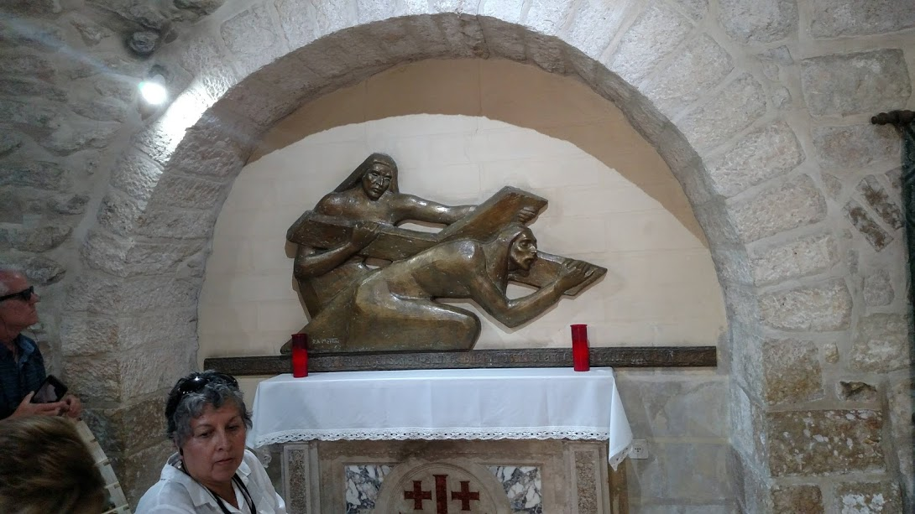
Jesus, Simon, one cross

Slide 27
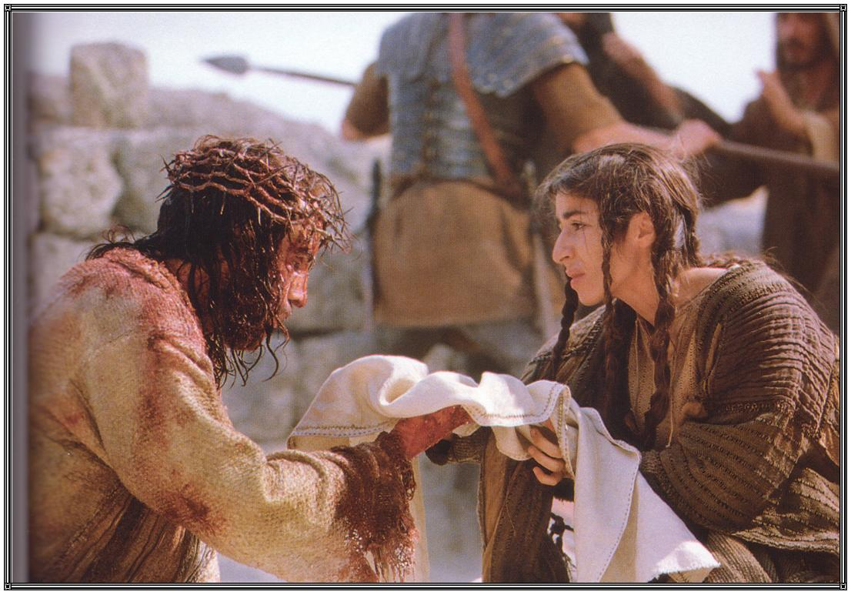
Veronica wipes his face
What you did for others who suffer,
You did for me

Slide 28
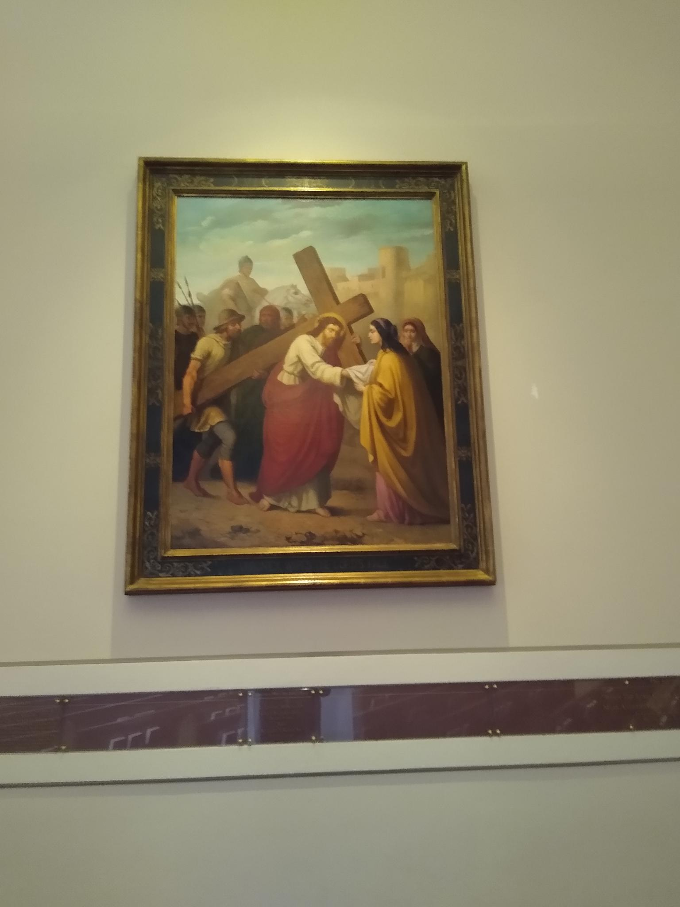
Don’t weep for me
Weep for yourselves and your children
If this happens to the good wood, what will happen to the bad wood?

Slide 29
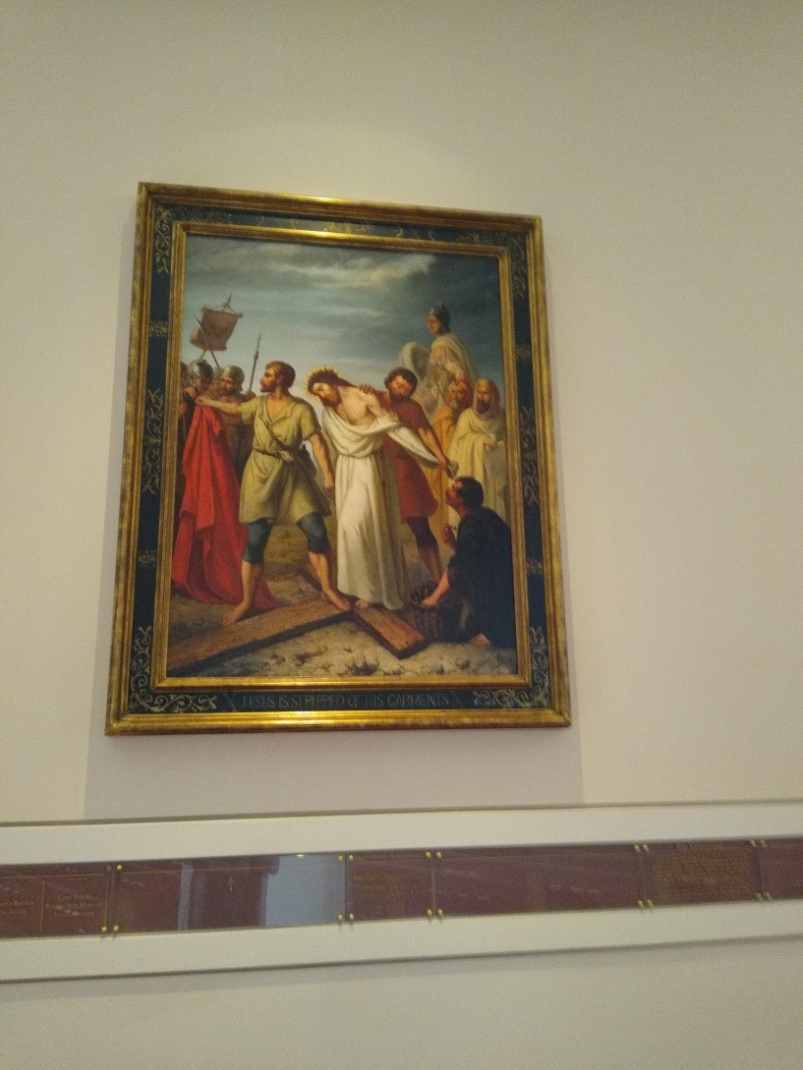
Jesus is stripped
Innocence has no shame
We will be stripped of all our lies and illusions of ourselves.

Slide 30
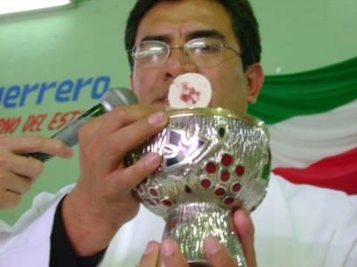
Divine Host
Eternal Father, I offer you the body and blood, soul and divinity of your dearly beloved Son, our Lord Jesus
Christ. In atonement for our sins and those of the whole world

Slide 31
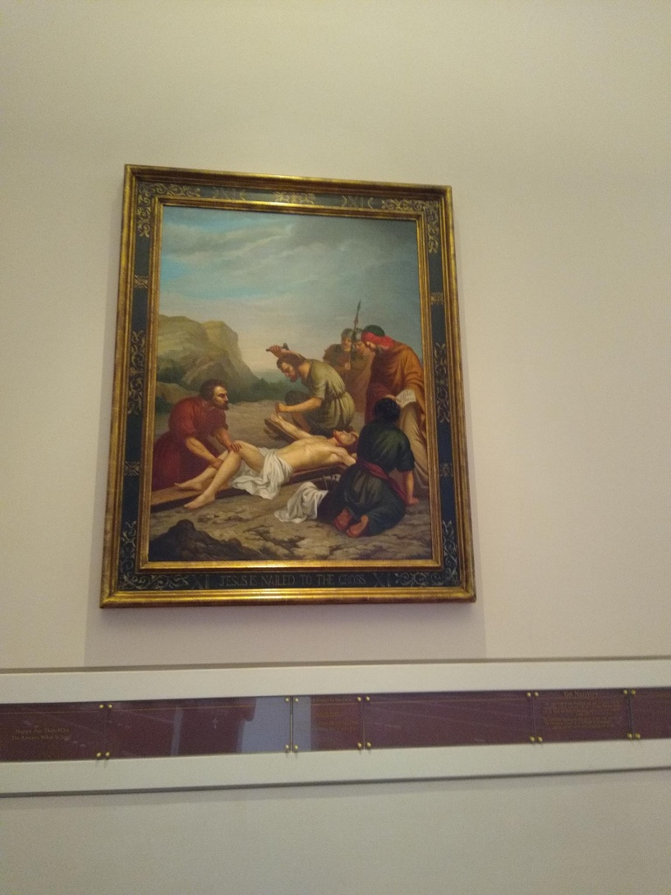
Nailed to the cross
The nails didn’t fasten him to the cross,
His love for us fastened him to the cross.

Slide 32
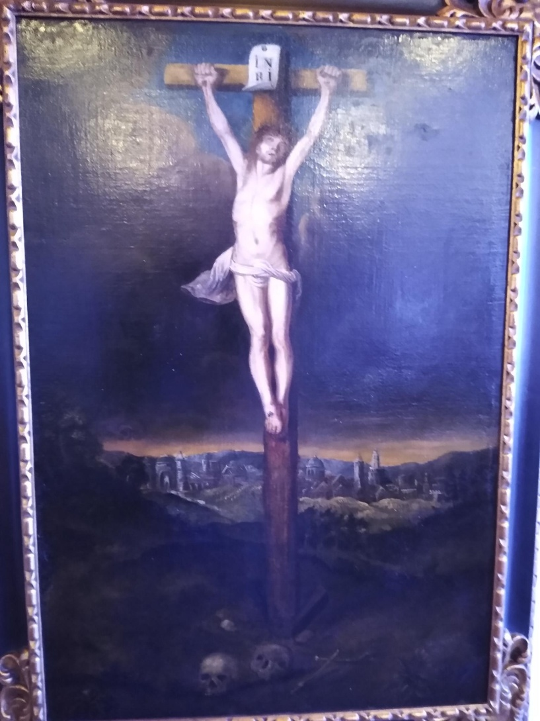
Father, forgive them
You will be with me.
Behold your mother
Father, why have you abandoned me?
I thirst

Slide 33
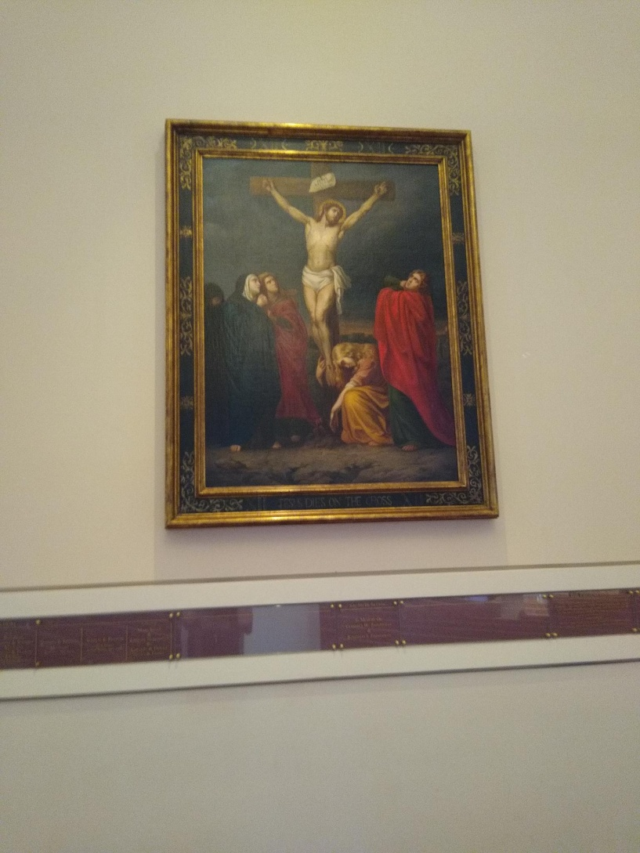
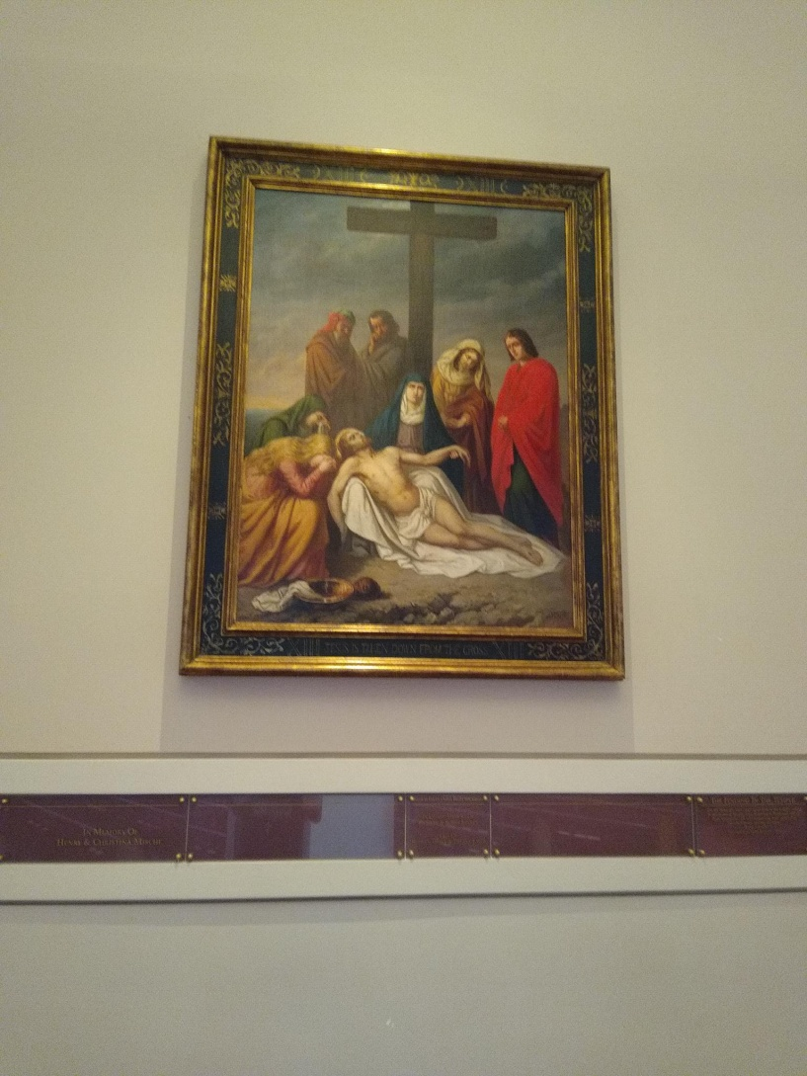
It is finished

Slide 34
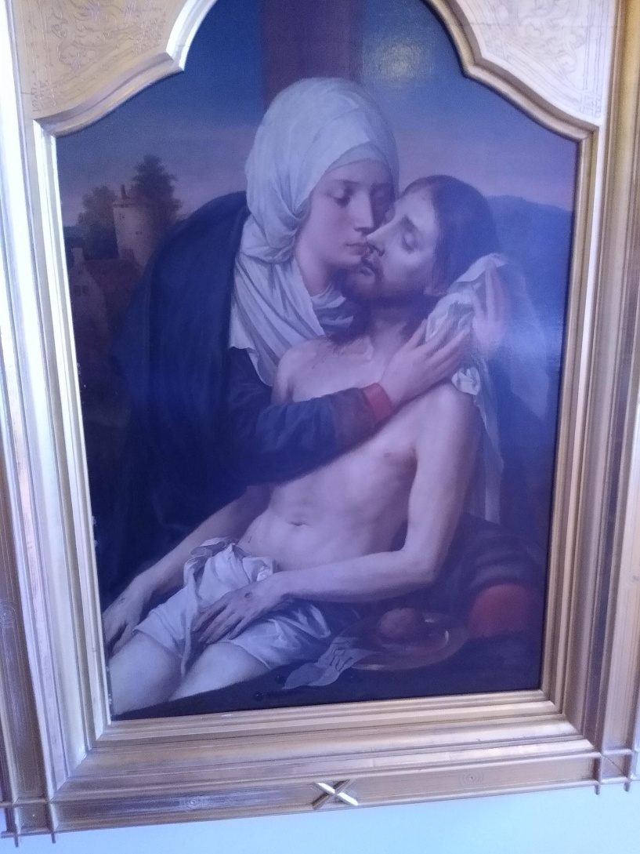
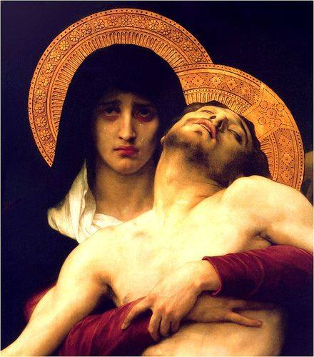
Our Lady of Sorrows

Slide 35
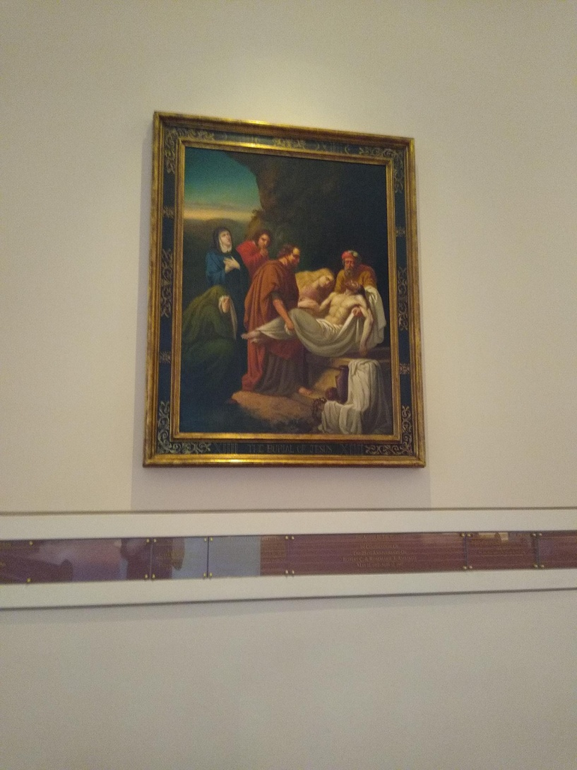
They laid him in a tomb
Unless a grain of wheat falls into the earth and dies, it remains a grain of wheat, but if it dies it bears much fruit.

Slide 36
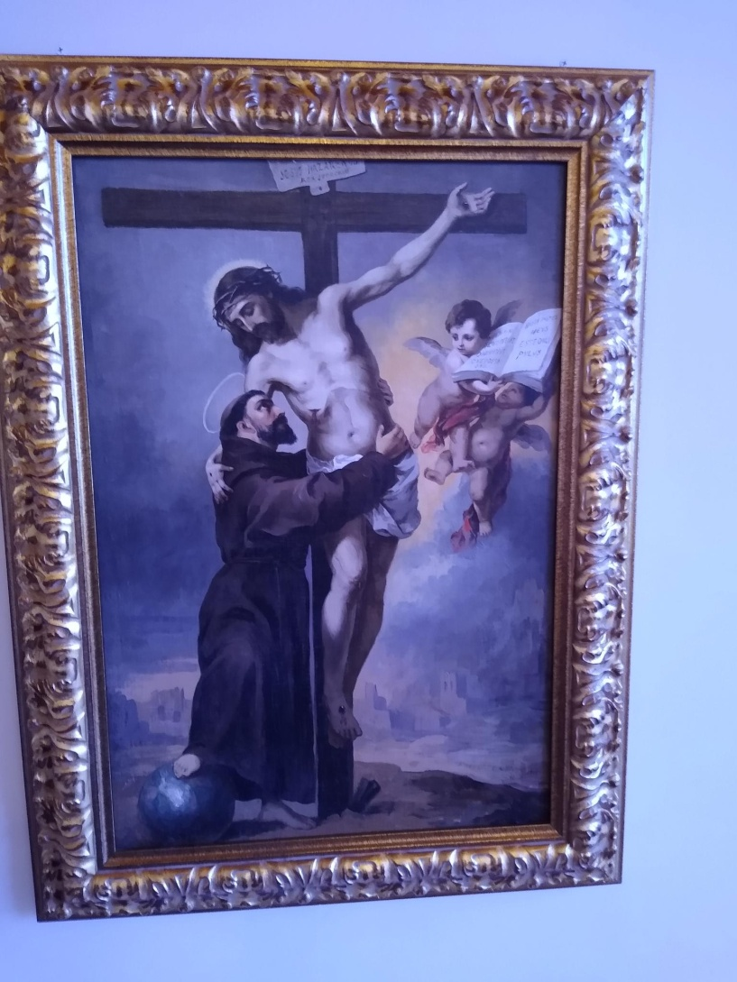
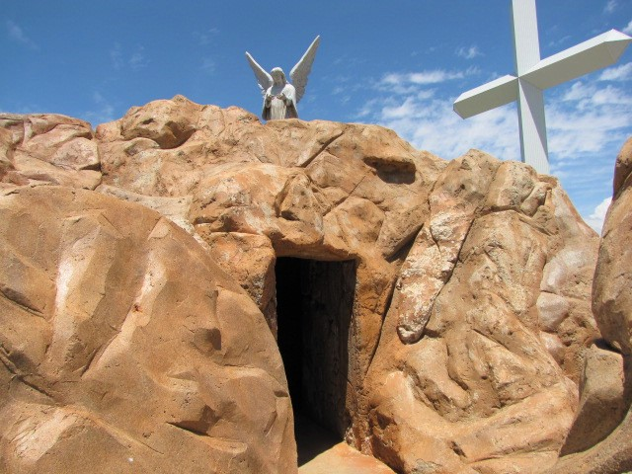

Slide 37
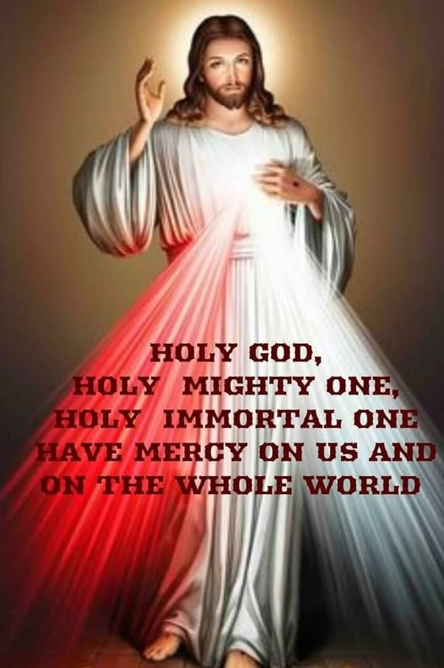
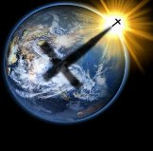
Three times

Slide 38
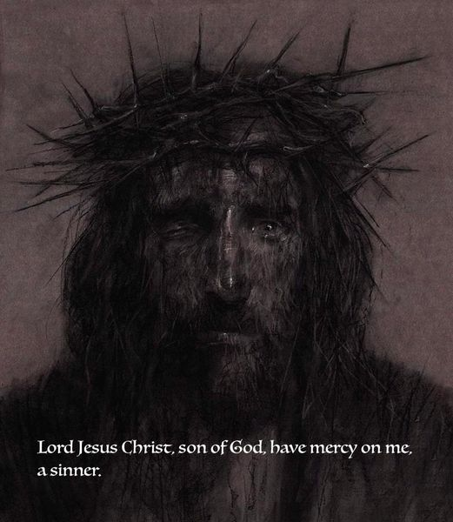
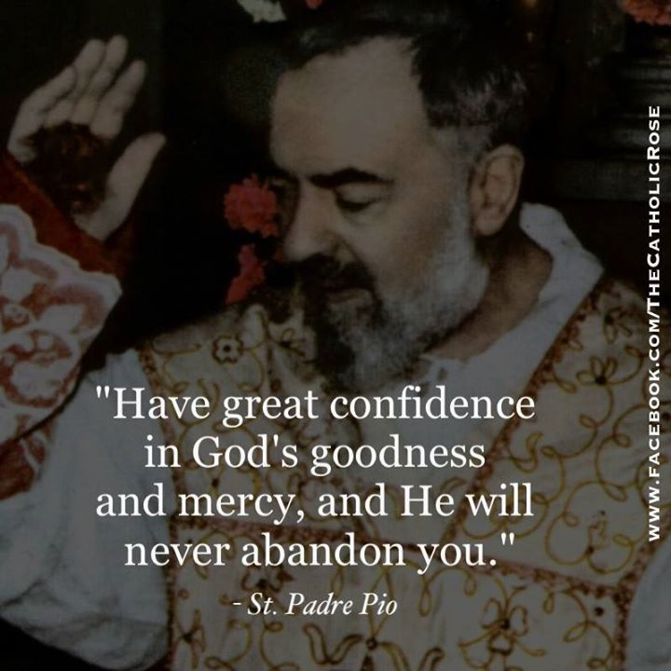
Be mercy as I am mercy

Slide 39
Ending Prayer
Eternal God, in whom mercy is endless, and the treasury of compassion inexhaustible, look kindly upon us, and increase your mercy in us, that in difficult moments, we might not despair, nor become
Despondent, but with great confidence, submit ourselves to your holy will, which is love and mercy itself. Amen
(p950)

Slide 40
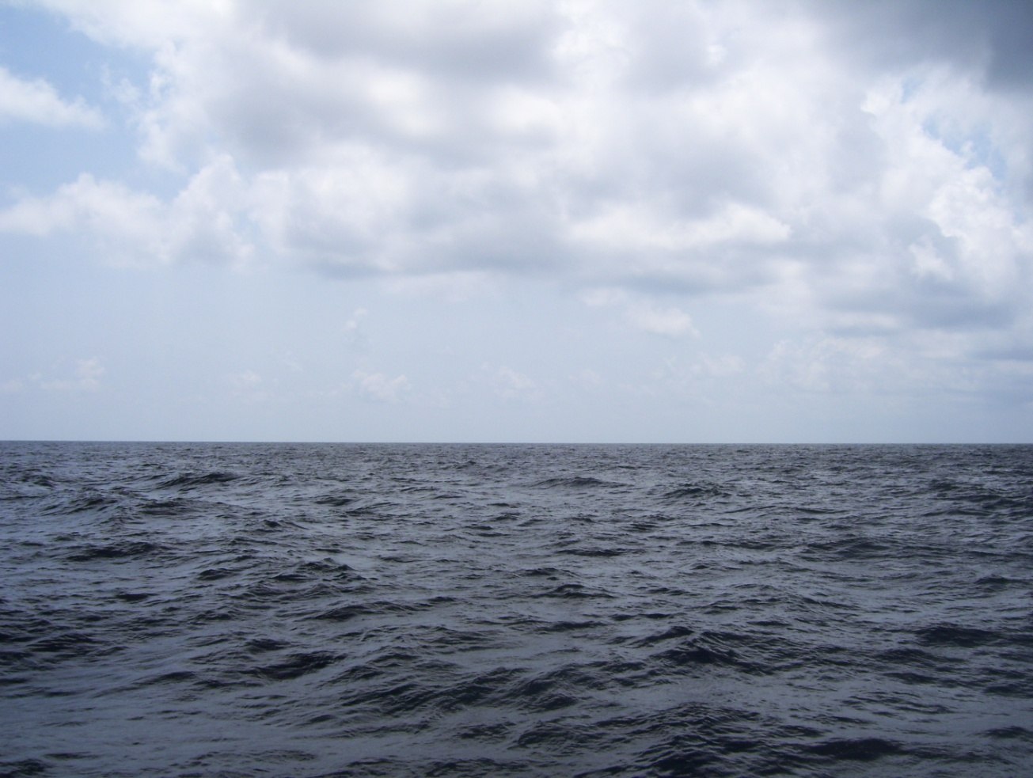

Slide 41
Some pictures are from Facebook, Passion of Christ and the Holy Land: Gethsemane, via Dolorosa, and stations of the cross at the Basilica of Mary, Queen of the Universe, Orlando Florida

