Slide 1
The Forgotten God
Fr Chris Alar
And Deacon Evan Wittig

Slide 2
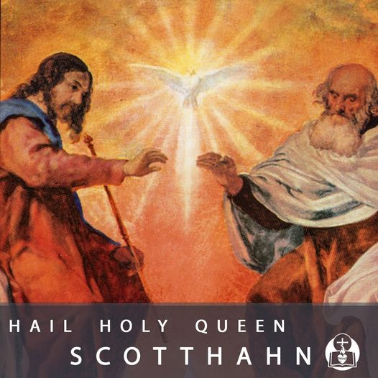
The Holy Spirit
The Forgotten Member of the Holy Trinity

Slide 3
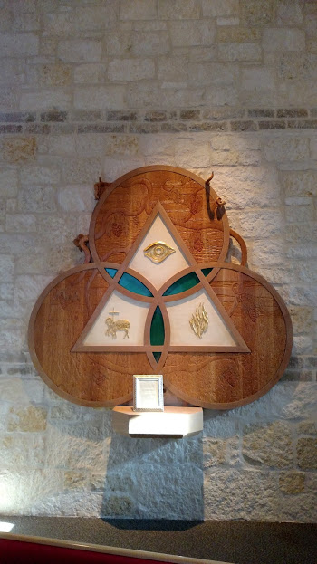
One God in Three Persons
FATHER IS GOD BUT NOT THE SON
THE SON IS GOD
BUT NOT THE FATHER
THE HOLY SPIRIT IS GOD BUT NEITHER FATHER OR SON

Slide 4
He Proceeds
He proceeds from the Father and the Son
Like a family
He is the Love of the Father for the Son and the Son for the Father
He is the bond

Slide 5
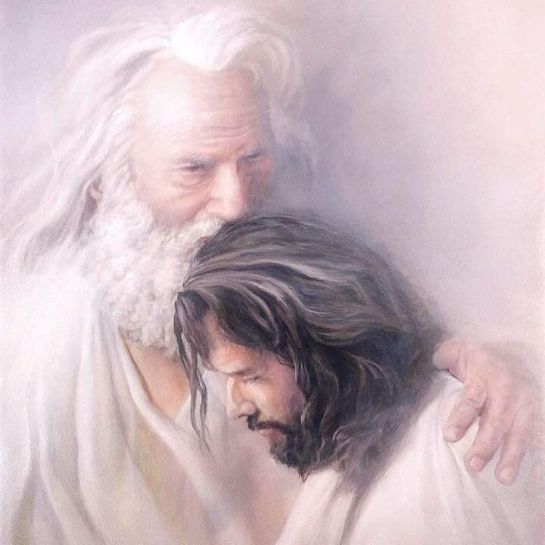
The Father thinks one Word
ONE WORD =
SON
= JESUS CHRIST
The Father speaks the One Word with One Breath, the Holy Spirit

Slide 6
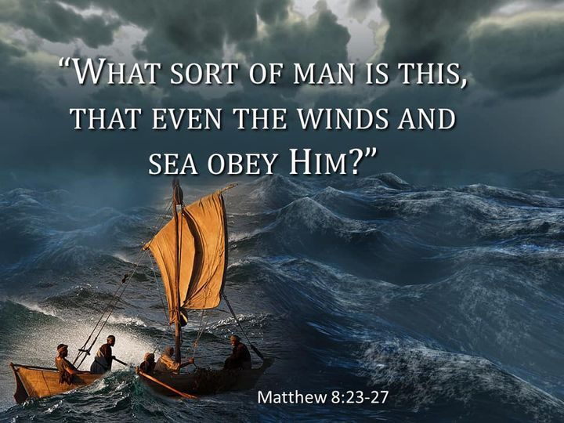
Ruah
Prounounced
Ruu ach
It means breath, air, wind, invisible energy power
Genesis, “The Ruah hovered over the waters.”

Slide 7
God’s plan of salvation
When the Father sends his Word, he always sends his Breath. In their joint mission, the Son and the Holy Spirit are distinct but inseparable. To be sure, it is Christ who is seen, the visible image of the invisible God, but it is the Spirit who reveals him. CCC 689
God sent his Son AND the Holy Spirit! Jn 3.16
To be sure, it is Christ who is seen, the visible image of the invisible God, but it is the Spirit who reveals him.

Slide 8
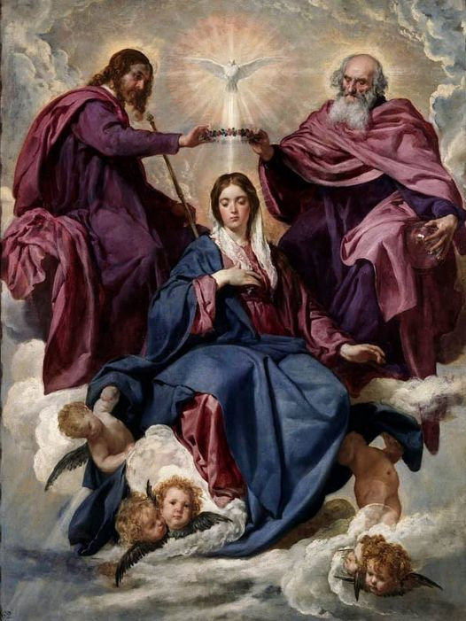
We go to heaven this way
Go back to God, to heaven, the way you came:
Go to Mary, then Holy Spirit, then Jesus, then the Father.

Slide 9
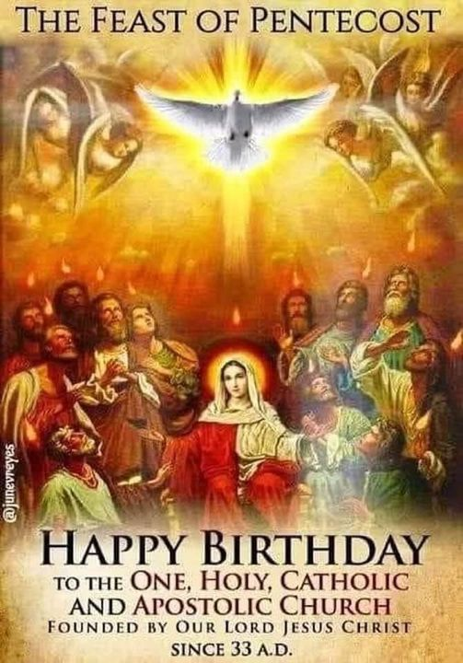
The Church and the Holy Spirit
Where there is Christ Jesus, there is the Catholic Church.“ In her subsists the fullness of Christ's body united with its head; this implies that she receives from him "the fullness of the means of salvation" ^{CCC} 830

Slide 10
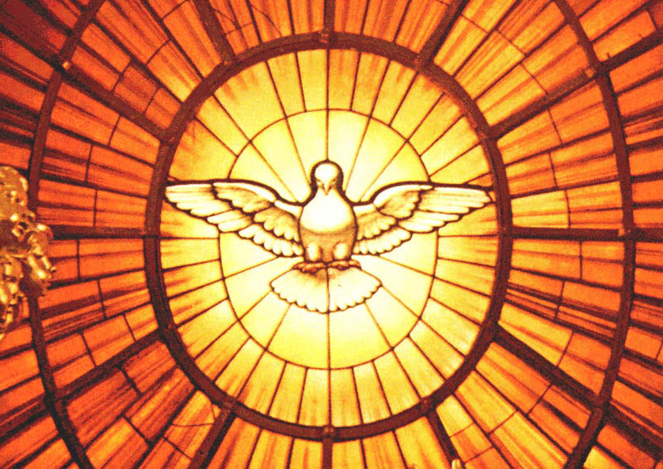
Invoked
We specifically invoke the Holy Spirit at every sacrament.
His plan is brought to completion in the Church, the Mystical Body of Christ (MBC) and Temple of the Holy Spirit.

Slide 11
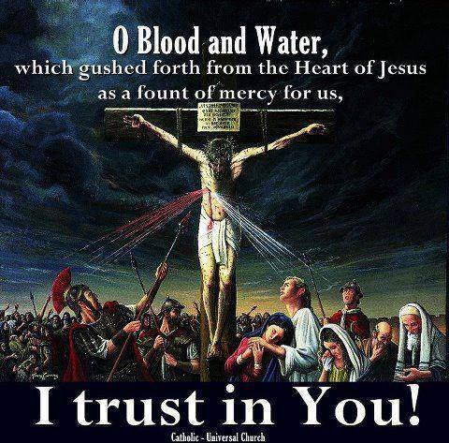
Sacraments and Holy Spirit
1116 Sacraments are "powers that comes forth" from the Body of Christ, which is ever-living and life-giving. They are actions of the Holy Spirit at work in his Body, the Church. They are "the masterworks of God" in the new and everlasting covenant.

Slide 12
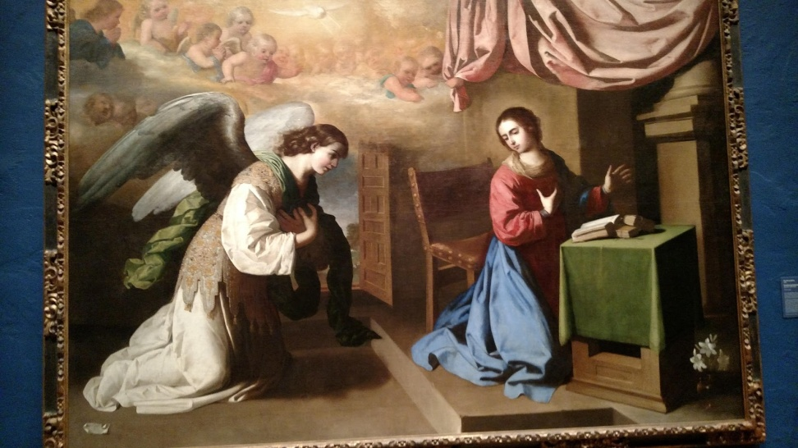
“Go and make disciples
Baptize them in the name of the Father and of the Son and of the Holy Spirit.”
At Confirmation we invoke the same Holy Spirit who came at the Annunciation and at Pentecost!

Slide 13
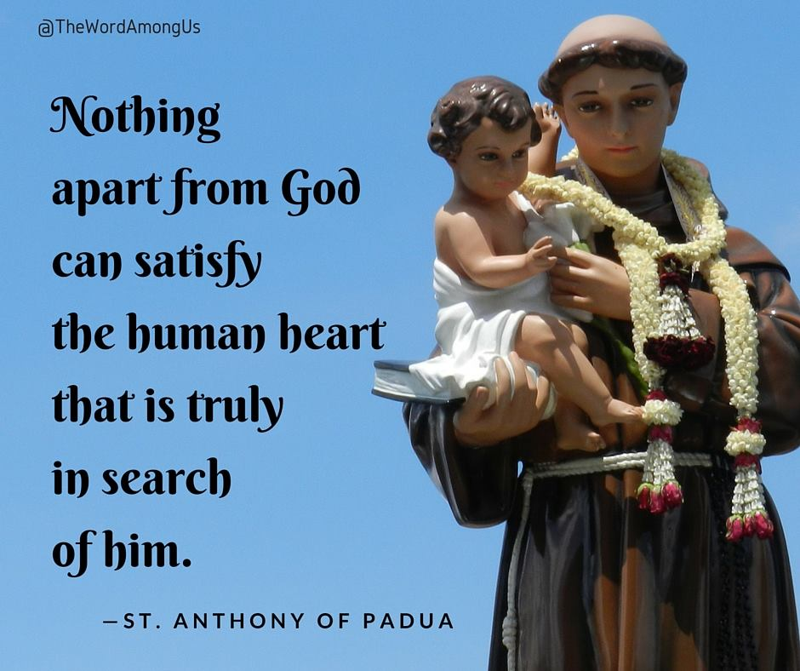
God’s Thoughts
Nobody comprehends the thoughts of God except the Spirit of God. He helps us understand the bible, the Church, the sacraments

Slide 14
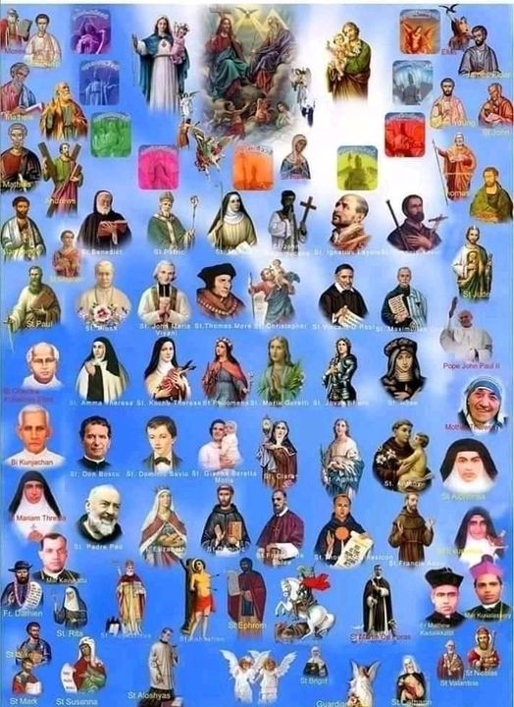
Holy Spirit Speaks
The Holy Spirit does not speak as Jesus of Nazareth did.
He speaks through the prophets in Old Testament; through the Bible, Tradition and Magisterium of Church and saints.

Slide 15
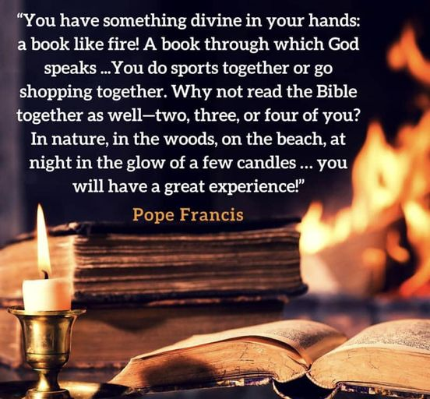
The Bible
The Bible contains both oral and written traditions. We read what the Church gave witness to. The Church, the Magisterium, interprets the bible.
The Holy Spirit is always focused on the Son only.

Slide 16
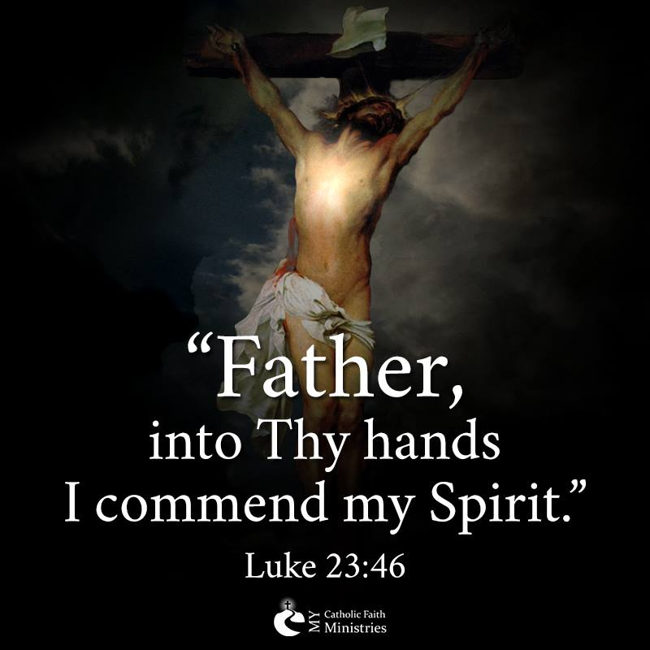
He doesn’t point to himself
The Holy Spirit points to the Son and the Father, so we forget him.
The Forgotten God

Slide 17
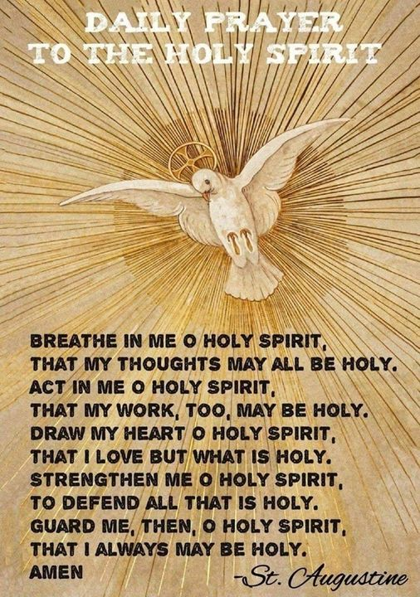
All We Need
With Holy Spirit we have all we need, the Lord and Giver of Life The Holy Spirit is the Personification of Grace! Grace is God’s Life.

Slide 18
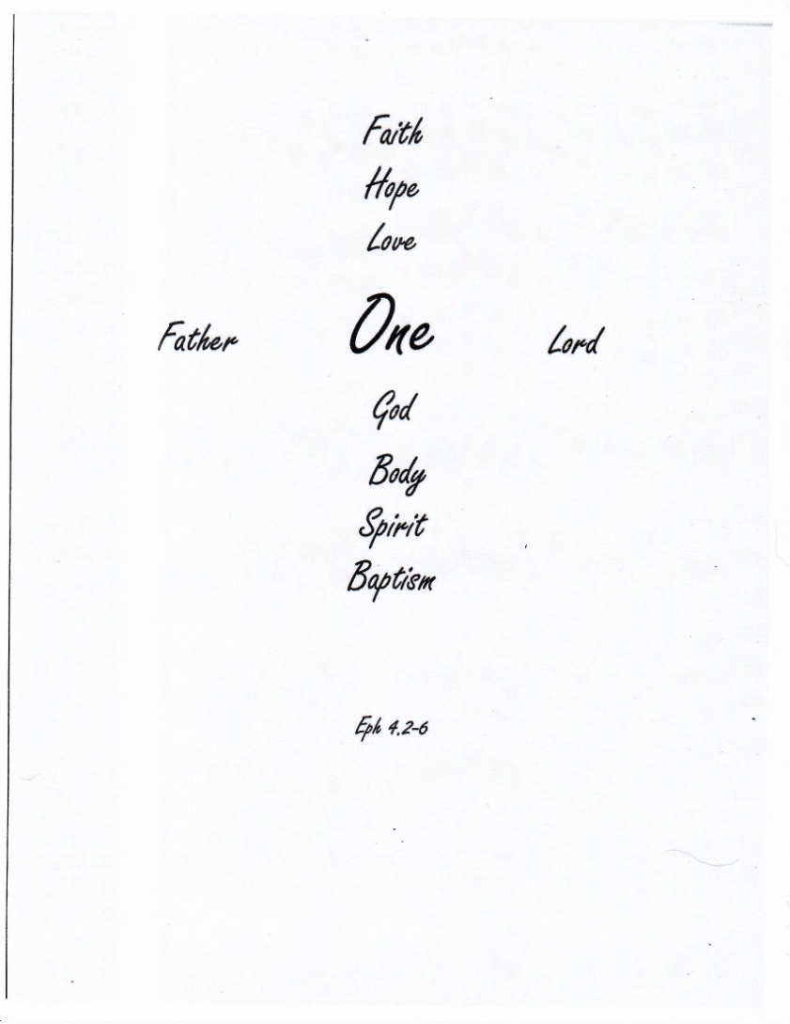
The Holy Spirit is the One Spirit and Soul of the Mystical Body of Christ, the Church.

