Slide 1

A Day with the Holy Spirit

Slide 2
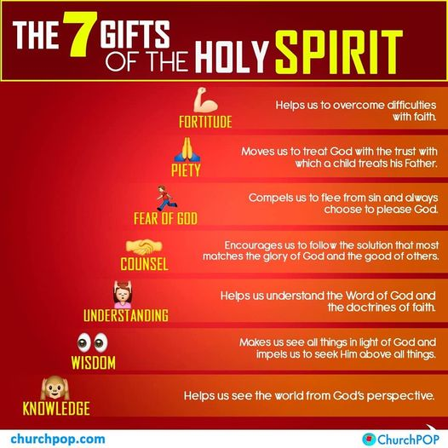
Gifts and Fruits of the Holy Spirit

Slide 3
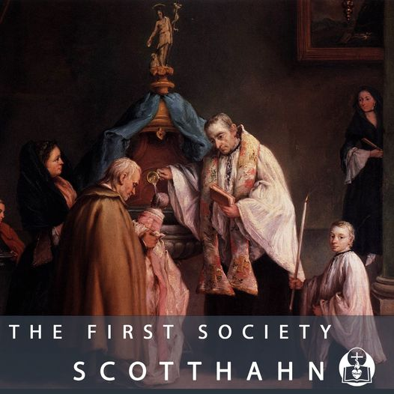
It Begins with Baptism
Baptism our “birth,” born again.
We receive the gifts of the Holy Spirit and the cardinal virtues of prudence, justice, fortitude and temperance.

Slide 4
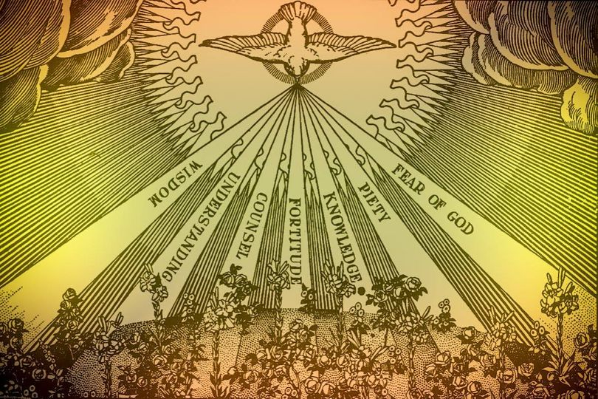
Then at Confirmation
Confirmation – strengthens us with sanctifying grace the power of the Holy Spirit at Pentecost.
We are “sealed” by the Holy Spirit and anointed by the bishop.

Slide 5
The Gifts of the Holy Spirit
CCC 1831 Gifts and Fruits of Holy Spirit are permanent dispositions to obey God. We lose them through mortal sin. Baptism (Prudence, Justice, Fortitude, Temperance).
1831 The seven gifts of the Holy Spirit are wisdom, understanding, counsel, fortitude, knowledge, piety, and fear of the Lord. They belong in their fullness to Christ, Son of David. They complete and perfect the virtues of those who receive them. They make the faithful docile in readily obeying divine inspirations.

Slide 6
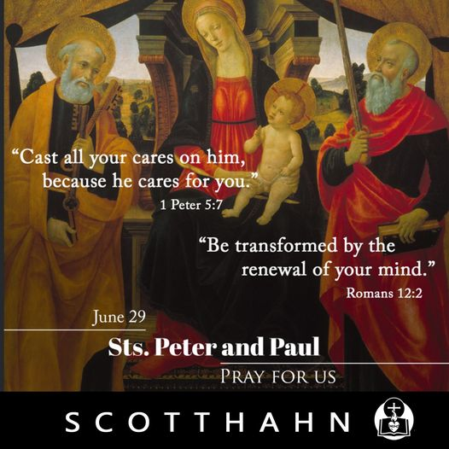
Divine Inspirations
the promptings of the Holy Spirit
Let your good spirit lead me on a level path. For all who are led by the Spirit of God are sons of God .. If children, then heirs, heirs of God and fellow heirs with Christ.
CCC1831

Slide 7
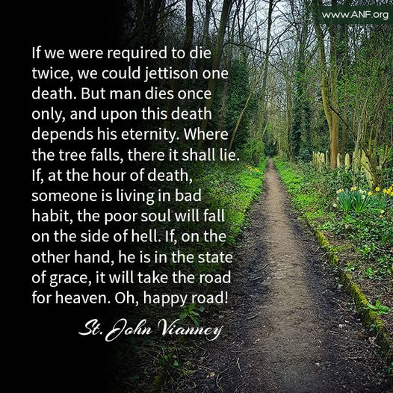
St John Vianney
Man by himself is nothing, but with the Holy Spirit he is very great. Why were the saints detached from the earth? Because they were led by the Holy Spirit.
Those touched by the Holy Spirit have true ideas.

Slide 8
Those led by the Spirit:
Distinguish between truth and lies, good and evil; see everything in it’s true proportion; see greatness in the least actions done for God and the greatness of the least faults; they cannot endure themselves, so well they know their misery… they see deep into eternity and experience all sorts of happiness in themselves; their heart expands and bathes itself in divine love; the Holy Spirit sends good thoughts; he brings out good desires. “O God, send me your Spirit to teach me what I am and what you are.”

Slide 9
God’s tool box
When a confirmed person makes spiritual progress, he grows in holiness by means of the gifts and fruits of the Holy Spirit.
Those who obey the promptings of the Holy Spirit are given the grace and the tools, like a tool box, but you have to USE the gifts to achieve holiness. The Holy Spirit empowers the gifts.

Slide 10
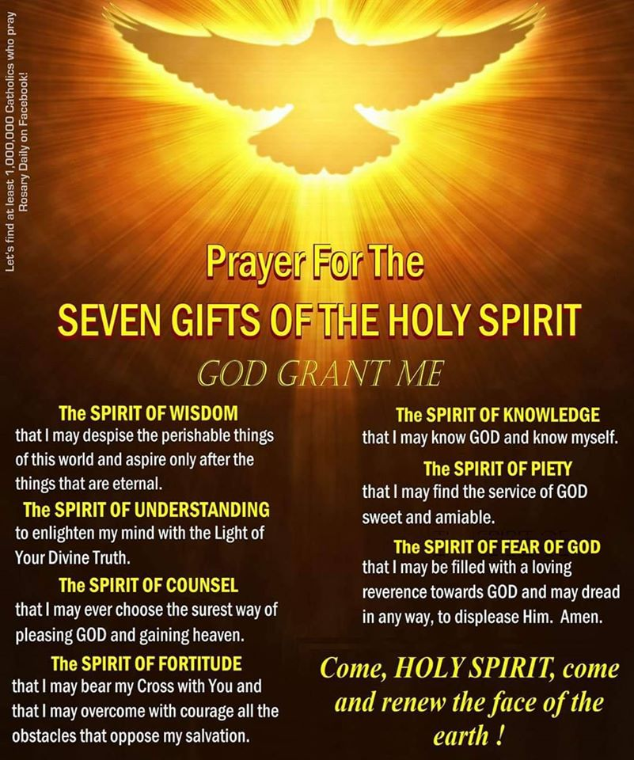
Wisdom and Understanding
Wisdom – the greatest gift. See things from God’s point of view. See God everywhere and in all situations.
Understanding – we comprehend how to live as a follower, a disciple, compassion for others.

Slide 11
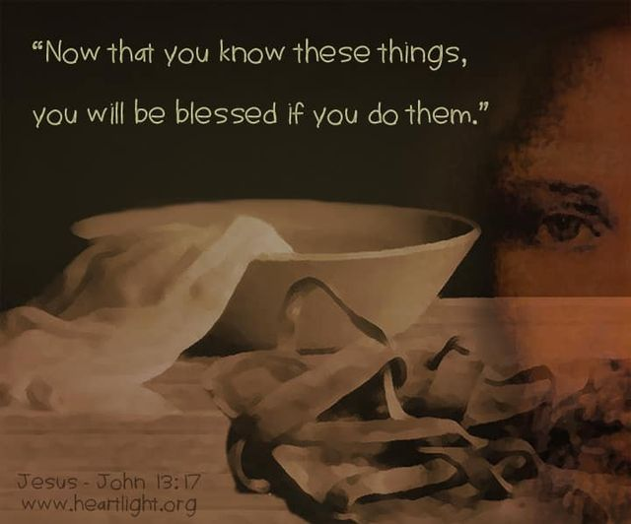
Knowledge and Piety
Knowledge – Data, teaching of faith, Bible, knowledge of God, knows meaning of things.
Piety – deep reverence for God and his Church, true worship of God, personal holiness

Slide 12
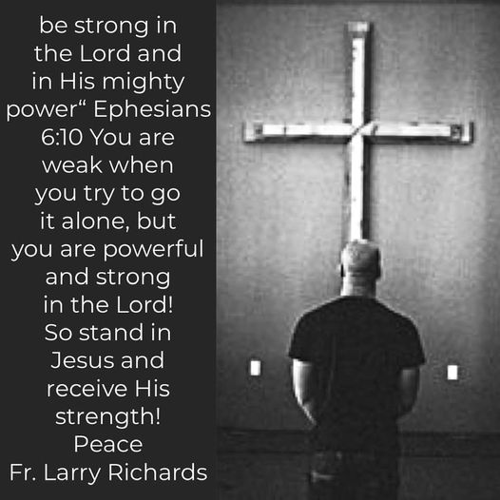
Council and Fortitude
Counsel – supernatural intuition; knows right from wrong and makes good decisions, gives good advice (you live it, then show it).
Fortitude – courage, resisting fear with strength, even martyrdom.

Slide 13
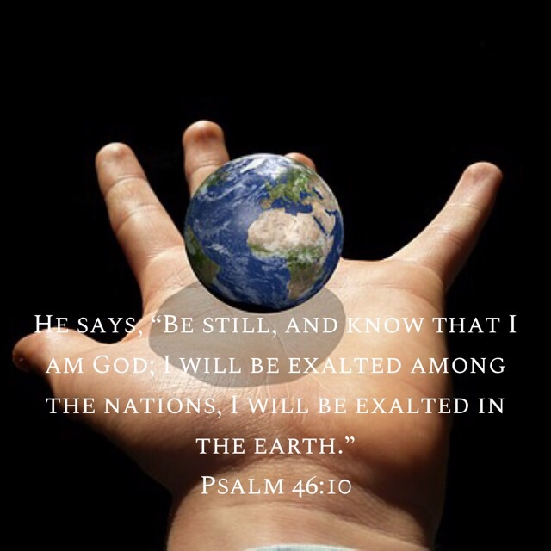
Fear of the Lord
Fear of the Lord – “shock and awe,” awareness of God’s awesomeness, his greatness and fear of offending the God we love and adore.

Slide 14
St John Vianney
Man is nothing the Holy Spirit is great.
Those led by the Spirit
Have true ideas
Experience happiness
Distinguish right from wrong
Gives good thoughts
Good desires

Slide 15
The Fruit(s) of the Holy Spirit
Our sinful nature pulls us away from God:
“Now the works of the flesh are obvious: immorality, impurity, licentiousness,
idolatry, sorcery, hatreds, rivalry, jealousy, outbursts of fury, acts of selfishness, dissensions, factions, occasions of envy,* drinking bouts, orgies, and the like. I warn you, as I warned you before, that those who do such things will not inherit the kingdom of God.” Gal 5.19-21

Slide 16
Paul’s list of fruit
“In contrast, the fruit of the Spirit is love, joy, peace, patience, kindness, generosity, faithfulness, gentleness, self-control. Against such there is no law. Now those who belong to Christ [Jesus] have crucified their flesh with its passions and desires.” Gal 5.22-24

Slide 17
St Jerome’s List of Twelve fruits
1832 “The fruits of the Spirit are perfections that the Holy Spirit forms in us as the first fruits of eternal glory. The tradition of the Church lists twelve of them: "charity, joy, peace, patience, kindness, goodness, generosity, gentleness, faithfulness, modesty, self-control, chastity."

Slide 18
Paul’s Love 1 Cor 13
“If I speak in human and angelic tongues* but do not have love, I am a resounding gong or a clashing cymbal…. If I do not have love, I am nothing. Love is patient, love is kind. It is not jealous, [love] is not pompous, it is not inflated, it is not rude, it does not seek its own interests, it is not quick-tempered, it does not brood over injury, it does not rejoice over wrongdoing but rejoices with the truth. It bears all things, believes all things, hopes all things, endures all things.”

Slide 19
Joy
““I have told you this so that my joy may be in you and your joy may be complete.^{” Jn 15.11}
“For the joy that lay ahead of him, he endured the cross, heedless of it’s shame.” Heb
“My spirit rejoices in God my savior.” Luke 1
“Shout joyfully to the LORD, all you lands;
serve the LORD with gladness; come before him with joyful song.” Ps 100.1-2

Slide 20
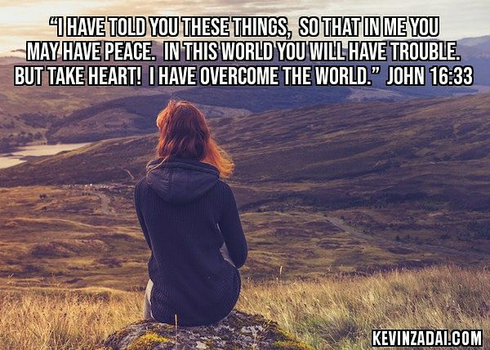
Peace
“My peace I give you, not as the world gives peace.”
“Peace be with you.”
‘Peace be unto this house.”
Jesus is the Prince of Peace
God is our peace.

Slide 21
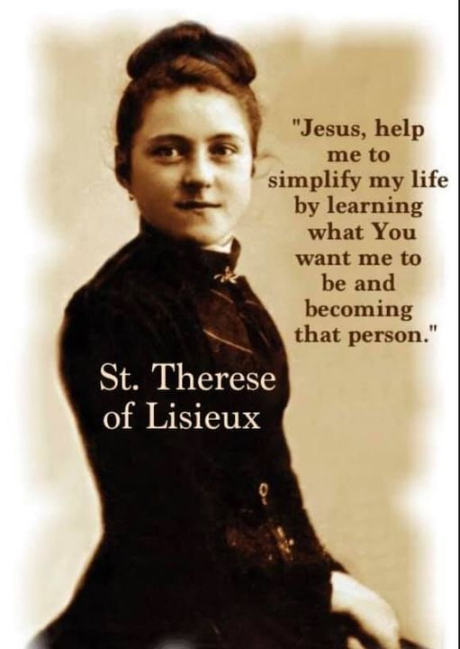
The meek shall inherit the earth
Patience – God’s time is not our time. It has to do with love of neighbor.
Kindness
Goodness
Gentleness
Degrees of love and humility

Slide 22

Self Control
Faithfulness – holding on to the truth and your promises
Modesty, self-control, chastity
A person who masters himself is a true master. The body is a temple of Holy Spirit.

Slide 23
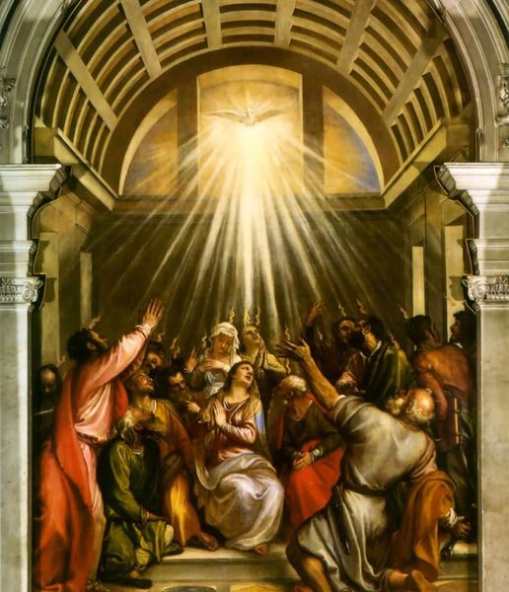
The Holy Spirit is The Gift

